Slide 1

Assignment-1 (Silo Analysis)
(Vedanta Resources Ltd.)
Rishi Kachhwaha (Summer Intern, IIT Kanpur)
Mentor - Sandeep Sir
Anchor – Anjali Ma’am

Slide 2
Problem Statement
As per information, there are 2 sources of imported alumina.
Operations team claim that there are high Na alumina and low Na alumina.
As there is no specific alumina being maintained exclusively for Balco,
Why does the test analysis is in concurrence to the COA produced for Balco?

Slide 3
Procedure (Vessels to Balco)
1) Arrival of Ship Vessel:
Ship vessels carrying alumina are sent by the sellers (with defined COA) arrives at designated port/dock (ours is Kakinada port)
2) Suction Pumps:
These pumps are employed to extract alumina from vessel compartments. These pumps create vacuum and draw the alumina into their intake system.
3) Intake Pipes:
The intake pipes of the suction pumps are connected within the ship's cargo area to extract the alumina. (These points are designed to prevent spillage or contamination.)
4) Alumina Silos: The extracted alumina is directed through the suction pumps and transported via pipes to designated silos on the port premises.
5) Silo Storage: silos are large cylindrical structures with sufficient capacity to store alumina. The silos are designed to ensure proper ventilation and prevent moisture or other contaminants.
6) Silo Intake: silos have 6 air slides on the top of silos. They provide low pressure air to create a fluid-like state of alumina granules. Aiding efficient discharge of material and random distribution on the top of layer.
Continued on next pg.

Slide 4
Continued…
6) Bottom Discharge Point: According to alumina demand, Each silo is discharged with a bottom discharge point or opening. At Kakinada port we have single point discharge silos.
7) Loading into Racks: To transport the alumina from the silos to its destination, such as Balco or Jharsuguda, the bottom discharge point of the silo is connected to conveyor belts, and other equipment
8) The loading mechanism, guides alumina into wagons, racks, or trucks for transportation. These vehicles are positioned below the discharge point to ensure efficient and safe transfer of the alumina.
9) Once loaded, the wagons are dispatched to their respective destinations, such as the Balco or Jharsuguda alumina processing facilities. The transportation may involve road or rail networks.
10) Alumina Processing: Upon reaching their destination, the alumina is received by the processing facilities at Balco or Jharsuguda. These facilities further refine and process the alumina to extract aluminium.
Continued on next pg.

Slide 5
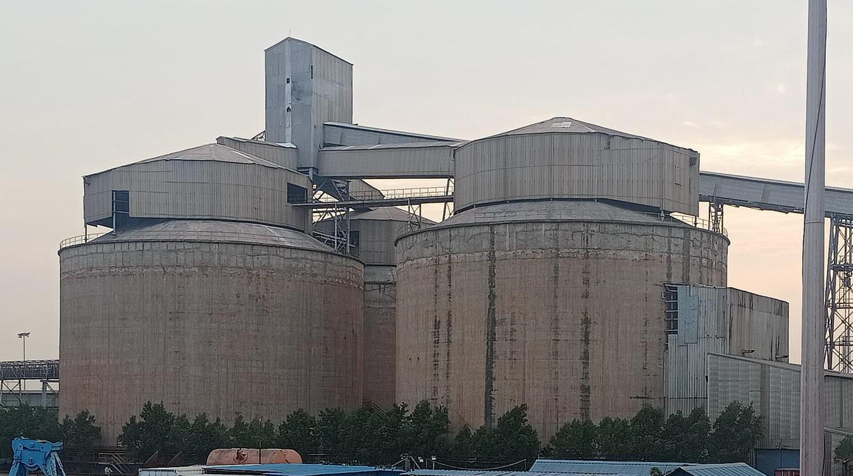
Kakinada Silos

Slide 6
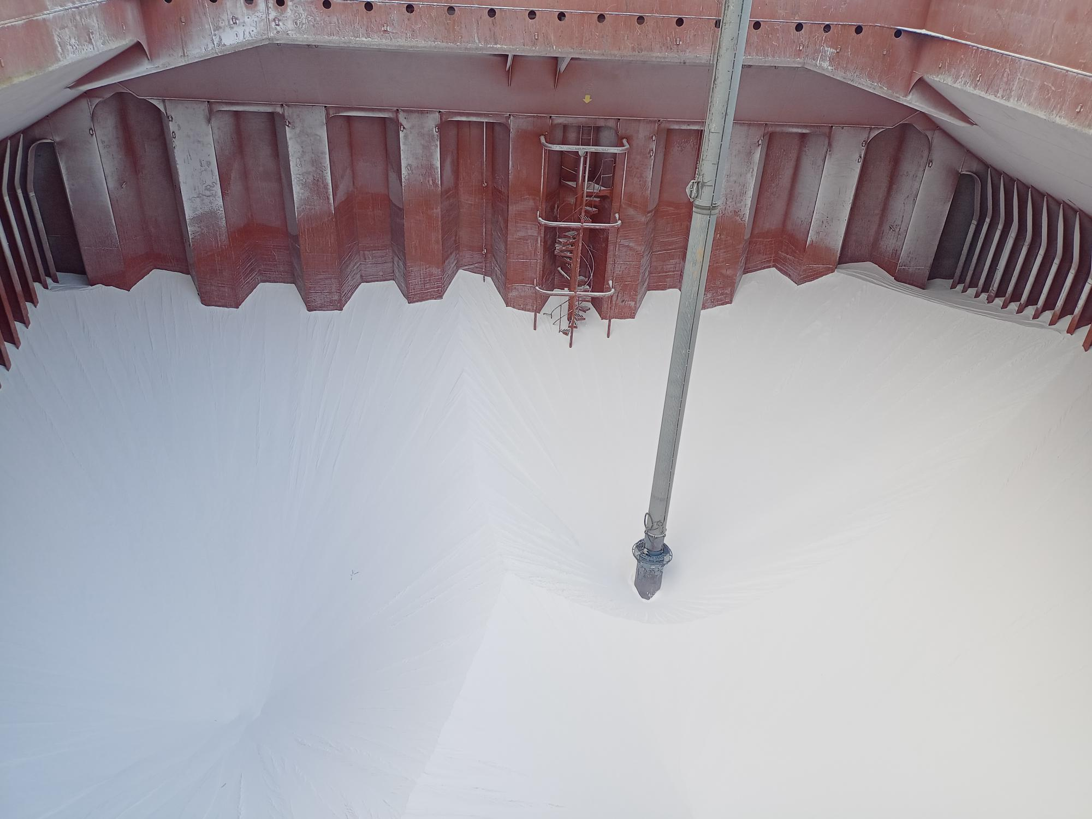
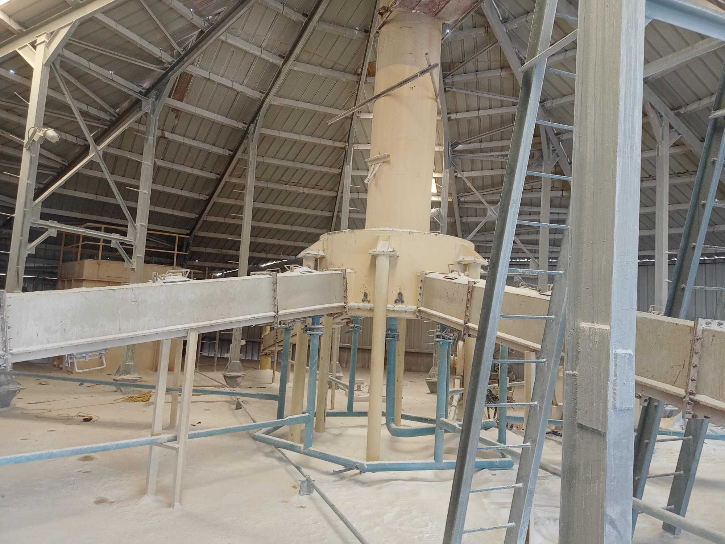
Suction Pumps and intake pipes visual
6 Air Sliders on the top of silo

Slide 7
Key Information received from Kakinada site visit
Vedanta (Jharsuguda) has 3 silos, they distribute both Us and Jharsuguda.
Ship vessels come in frequent intervals and get stored in the silos randomly, which is free to load.
Capacity of Silos are 22.5 KL each, but they are filled to an extent of 21 KL only.
The Silos have air slides on the top that allows uniform distribution of alumina granules.
Angle of Steepness of silo bottom is only 10 degrees.
The bottom discharge point of silo is a rotary spin discharge, with only a single point.
After discharge, using conveyer belts and pipes the alumina is loaded onto the racks for further transport.
There Is no fixed amount delivered to Jharsuguda or the Balco plant, it all depends on the order amount, less amount is given more preference.
Silo Discharge rate – 700 tph (tonnes per hour), Silo Feed rate – 400 tph
Port In-charge said that there will be mixing in the silo layer if there are significant amount of more than one COA alumina present inside, but if there is very less amount of alumina present inside the silo then obviously seller defined COA will be observed.
I’LL BE ANALYSING ASSUMING THAT THERE IS A SIGNIFICANT AMOUNT OF DIFFERENT COA ALUMINA PRESENT INSIDE THE SILO.

Slide 8
Analysing Approach
If you are receiving alumina from different suppliers with varying specifications and you are storing it in silos, it is expected that the material will mix to some extent within the silo. However, it's important to note that the degree of mixing can depend on several factors, including the
design and operation of the silos,
the flow properties of the alumina, and
the duration of storage.
However, there are a few possibilities that could explain why you are receiving alumina with the same COA as instructed by the seller:
Uniformity of Alumina Batches: If the suppliers provide alumina with consistent specifications, there may not be significant variations in the COA between the different batches.

Slide 9
Analysing Approach
Segregation during Discharge: Even if there is some mixing in the silo, the discharge process itself could lead to segregation, resulting in batches that closely resemble the original COA values. Factors such as flow patterns, discharge mechanisms, and handling equipment can affect the segregation of alumina during extraction from the silo.
It's worth noting that the behavior of alumina in silos can be influenced by various factors, and the specific circumstances at your facility may differ.

Slide 10
Alumina Properties
Alumina is a widely used material in various industries, and its properties can vary depending on the specific form and grade. Here are some general properties of alumina granules:
Flowability: Alumina granules typically exhibit good flowability due to their fine particle size and low cohesiveness. They can flow relatively easily when subjected to gravity or other forces, allowing them to move within a silo or through a conveyor system.
Particle Size: Alumina granules can vary in particle size, ranging from fine powders to larger granules. The particle size distribution can impact flowability, with finer particles typically flowing more freely. The specific particle size distribution will depend on the manufacturing process and application requirements.
Cohesiveness: Alumina granules generally have low cohesiveness. This means they have a reduced tendency to stick together or form clumps, making them more prone to flow and mix within a silo.

Slide 11
Alumina Properties
However, it's important to consider the specific properties of the alumina granules in your application, as different grades or forms may exhibit varying levels of cohesiveness.
Density: The density of alumina granules can vary depending on factors such as particle size, porosity, and the presence of any additives or impurities. Generally, alumina granules have a density in the range of 3.95 to 4.1 grams per cubic centimeter (g/cm³), which is relatively high compared to some other materials.
Surface Characteristics: The surface of alumina granules can have varying degrees of roughness or smoothness, depending on factors such as the production process and any surface treatments applied. These surface characteristics can affect the flow and mixing behavior of the granules within a silo.

Slide 12
Alumina Properties
It's important to note that specific properties of alumina granules can differ depending on the grade, manufacturing method, and intended application.
Thus what we can conclude is that alumina is highly flowable, it is very fine and more it is fine the more flowable it is, it has low cohesiveness and also high density

Slide 13
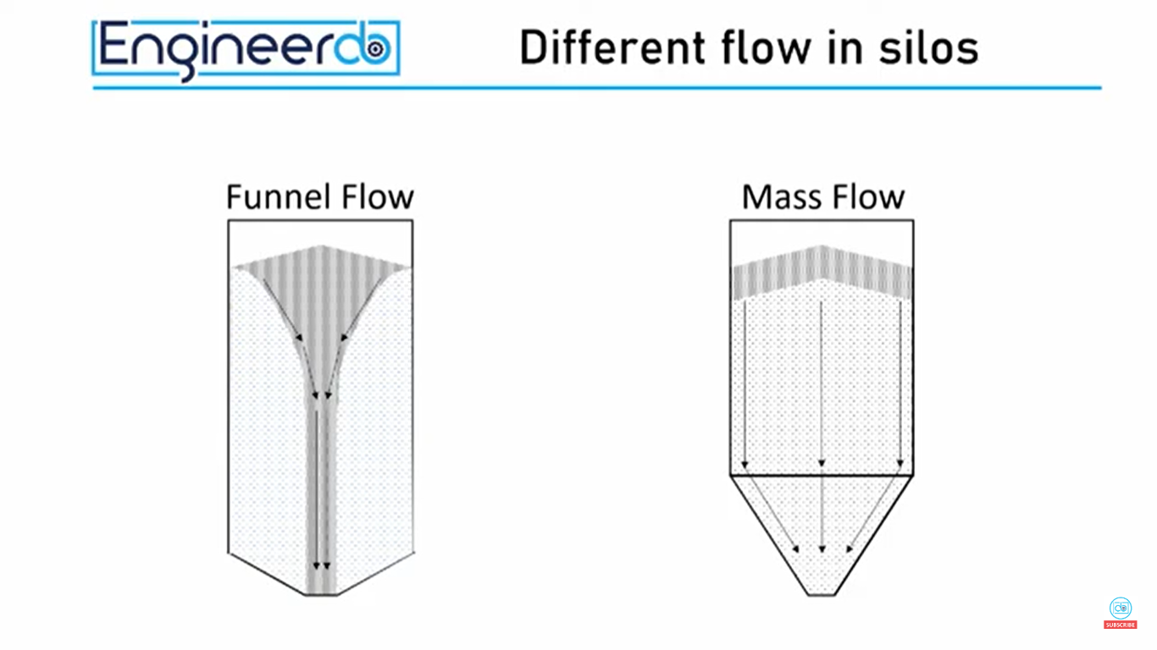
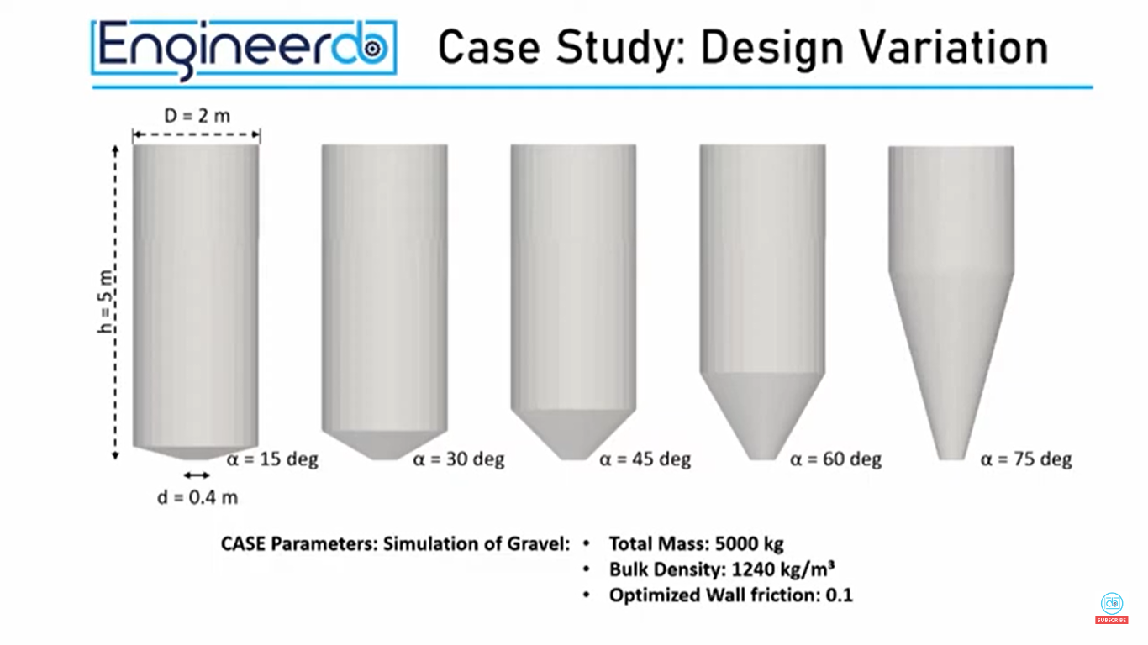
Flow in silo
Angle α
You can see that, steeper the angle α is, it will follow the mass flow (less amount of mixing)
And flatter the angle α is, it will follow the funnel flow (significant amount of mixing)
On the next page you can see the proper visuals.

Slide 14
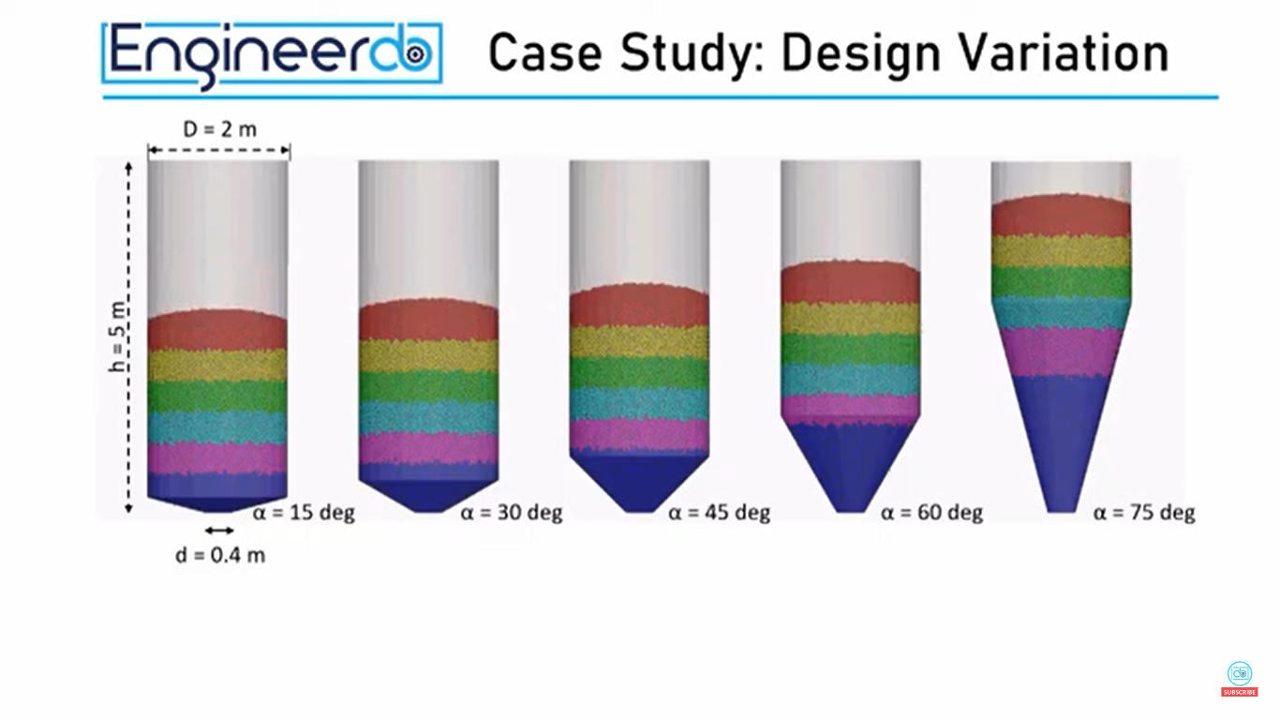
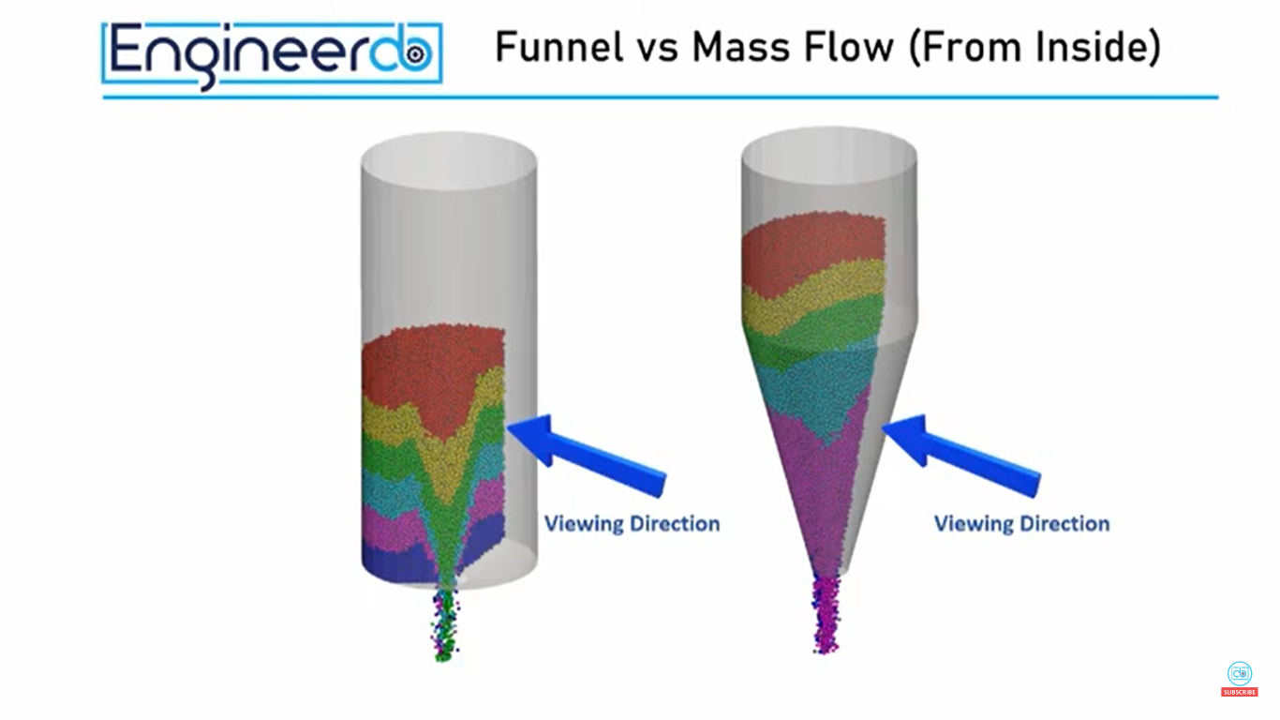
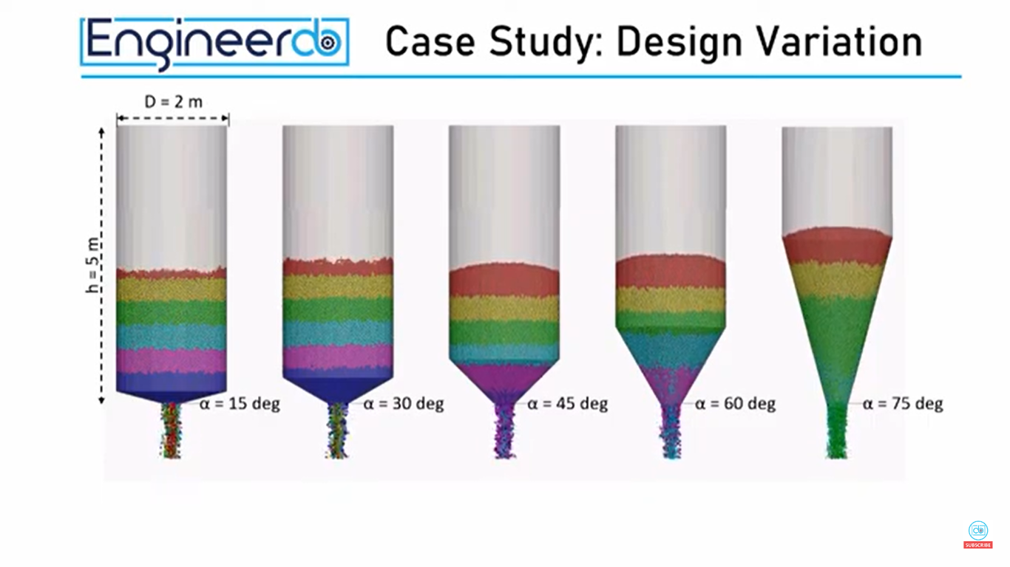
Flow in silo

Slide 15
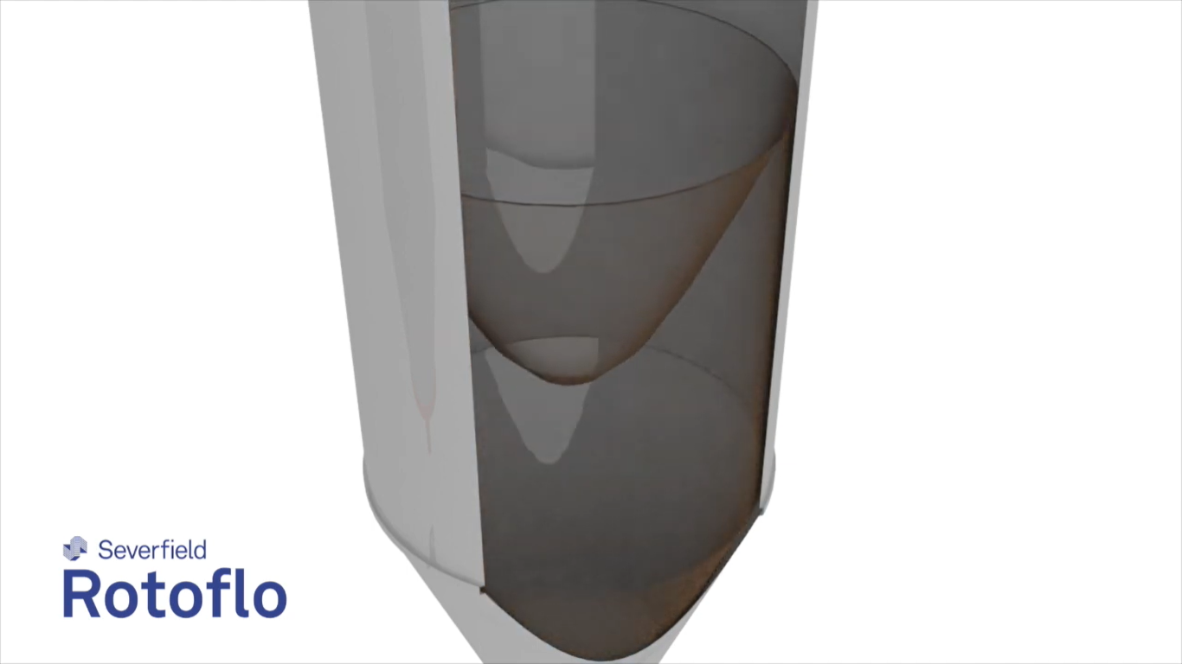
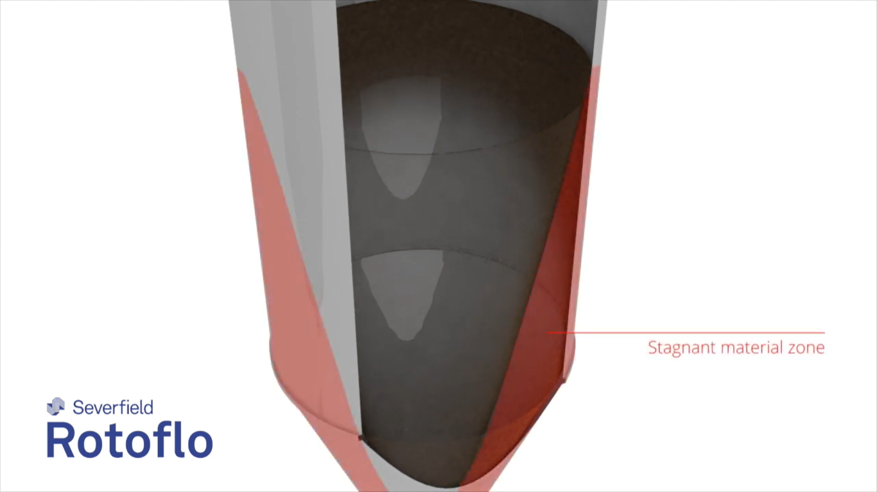
Rotary Discharge in Silo
Rotary Discharge is used because if we use a single point discharge which is static then there will be stagnation issues and that will cause our material to stick on the wall.
To avoid that we use rotary discharge which will keep on changing the funnel point and thus not causing any sticking on the wall.
On the next page you can find the mechanism of this rotary discharge.

Slide 16
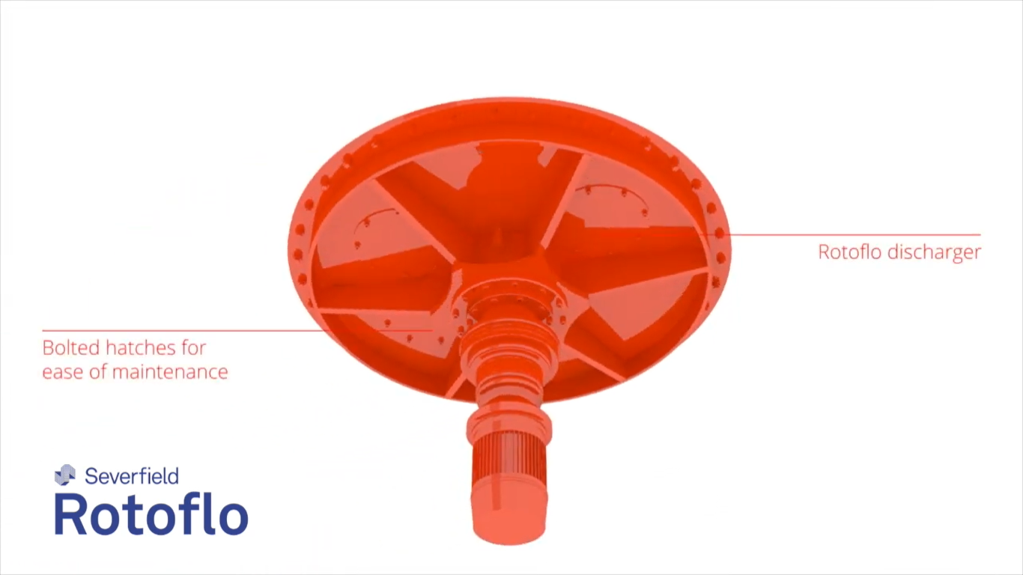
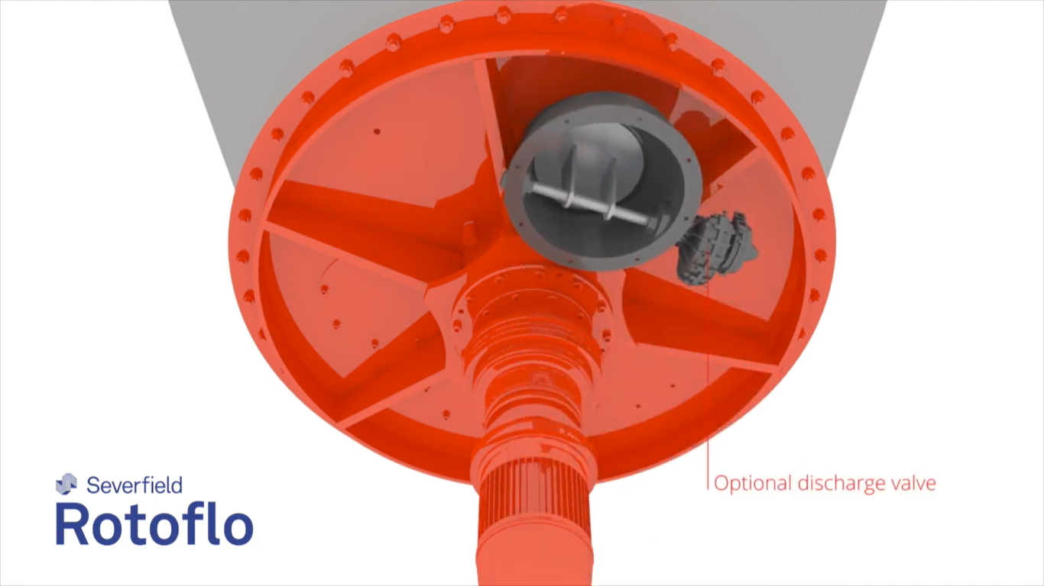

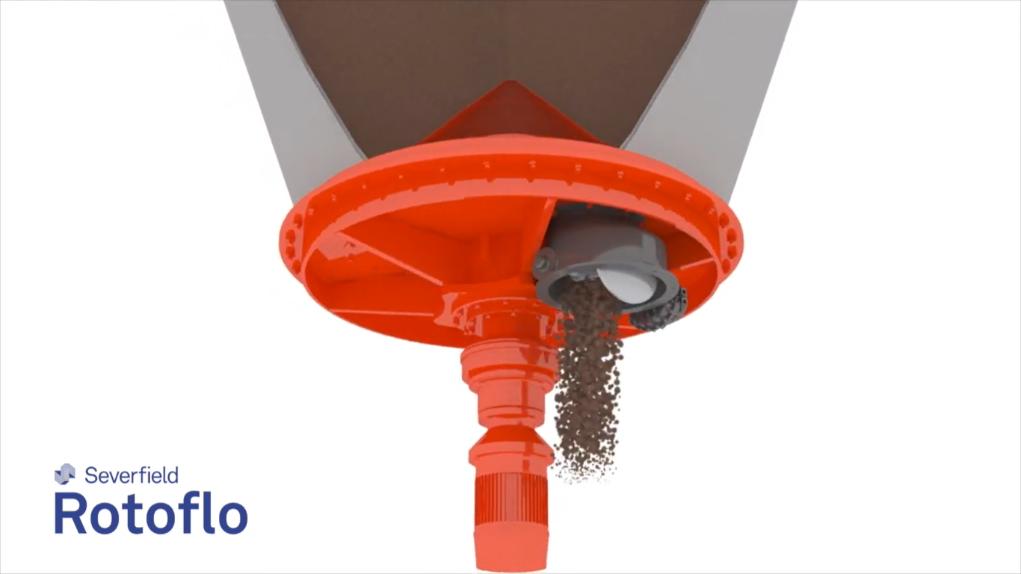
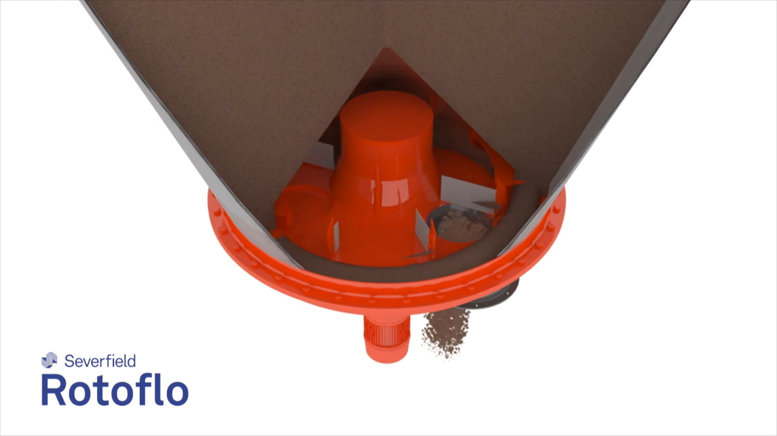
Rotary Discharge in Silo

Slide 17
Alumina in silo
When alumina is stored in silos, certain considerations should be taken into account to ensure proper handling and storage. Here are some key points regarding alumina in silos:
Flow Promotion: Alumina granules typically have good flowability, but it's important to ensure that the silo design promotes smooth flow. Silo geometry, including hopper angles and wall friction, should be optimized to prevent material bridging or stagnant regions that can hinder flow. Adequate aeration systems or mechanical devices, such as vibrators or air cannons, may be installed to assist in promoting flow and preventing blockages.
Silo Design: The design of the silo should consider the specific properties of alumina, such as particle size distribution and cohesiveness. The dimensions, slope angles, and discharge openings should be appropriately sized to accommodate the desired flow rate and prevent material segregation or compaction.

Slide 18
Alumina in silo
Moisture Control: Alumina granules are generally non-hygroscopic and not prone to moisture absorption. However, to maintain the desired properties of alumina, it is still important to protect it from excessive moisture during storage. Silos should be designed to prevent water ingress, and humidity control measures can be implemented if necessary.
Handling Equipment: Proper handling equipment should be used during the loading and unloading processes to minimize the risk of material degradation or contamination. Conveyors, bucket elevators, and other mechanical systems should be selected or designed to handle alumina gently and prevent excessive impact or abrasion.

Slide 19
Analysing conditions
Silos at our port have
10 degrees of steep angle
discharge rate of 700 tph
And rotary spin discharge with a single point opening
How does this affect your flow rate and mixing?
Alumina granules are typically fine particles composed of aluminium oxide (Al2O3). Alumina granules are generally known to have low cohesiveness and good flowability. Due to their fine particle size, they tend to flow relatively easily and exhibit good mixing behaviour.
A steep angle of 10 degrees and a discharge rate of 700 tonnes per hour indicate a relatively high flow rate. With a rotary spin and single-point discharge at the bottom, the material is likely to flow out in a funnel-shaped pattern and some mixing would occur within the layers of the silo.

Slide 20
Analysing conditions (Contd.)
The single-point discharge with rotary spin may aid in mixing, but it's important to ensure that the material is discharged evenly and not concentrated in a specific region. Thus proper silo outlet design is used to help achieve uniform discharge even if it causes mixing.
The discharge rate of 700 tonnes per hour also plays a role in the mixing process. A higher discharge rate may introduce more energy into the system, leading to increased mixing.
The discharge rate of 700 tonnes per hour suggests a relatively high flow rate, which can contribute to mixing as the material is being discharged and replaced. The rotary spin at the bottom of the silo can further aid in mixing by promoting material movement and preventing stagnant zones.

Slide 21
Graph and Data Analysis
From the next page you can find COA patterns of various sellers (and their vessels) and the test reports.
You’ll find that the COA specified by the seller and the COA observed in the test analysis are different and not in concurrence.
Thus it proves that the alumina are mixing and that can be seen in the data also.

Slide 22
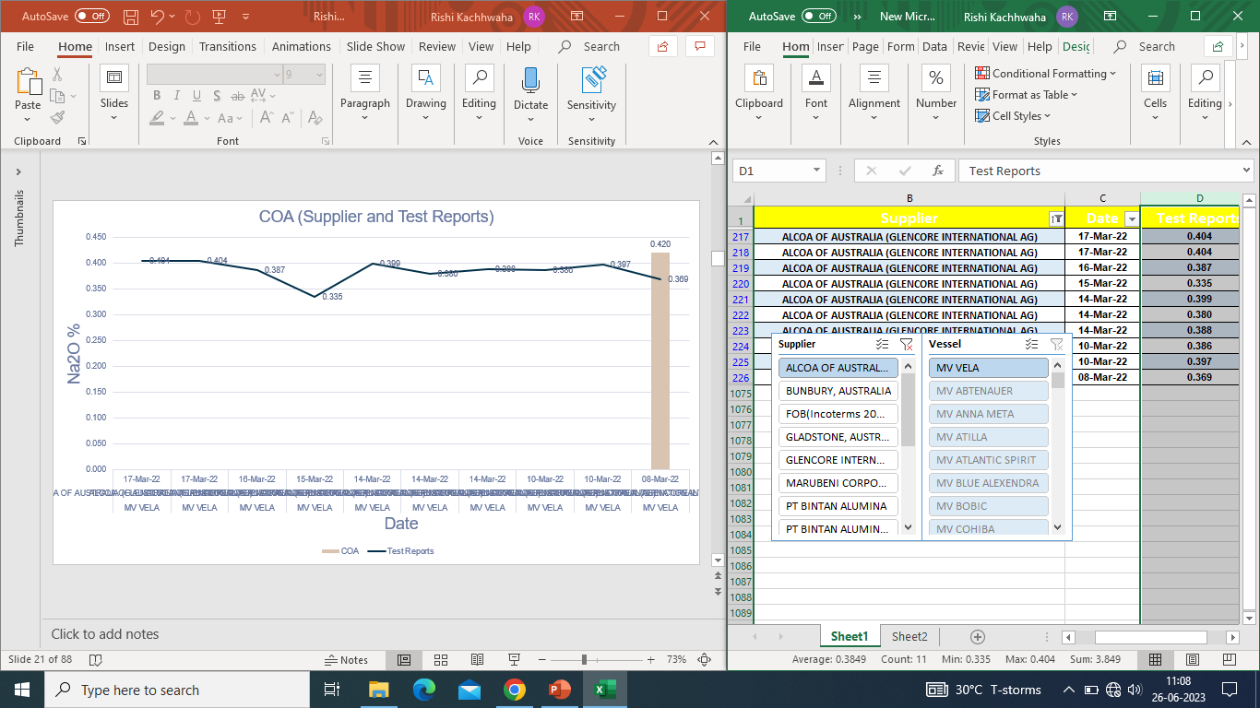

Slide 23
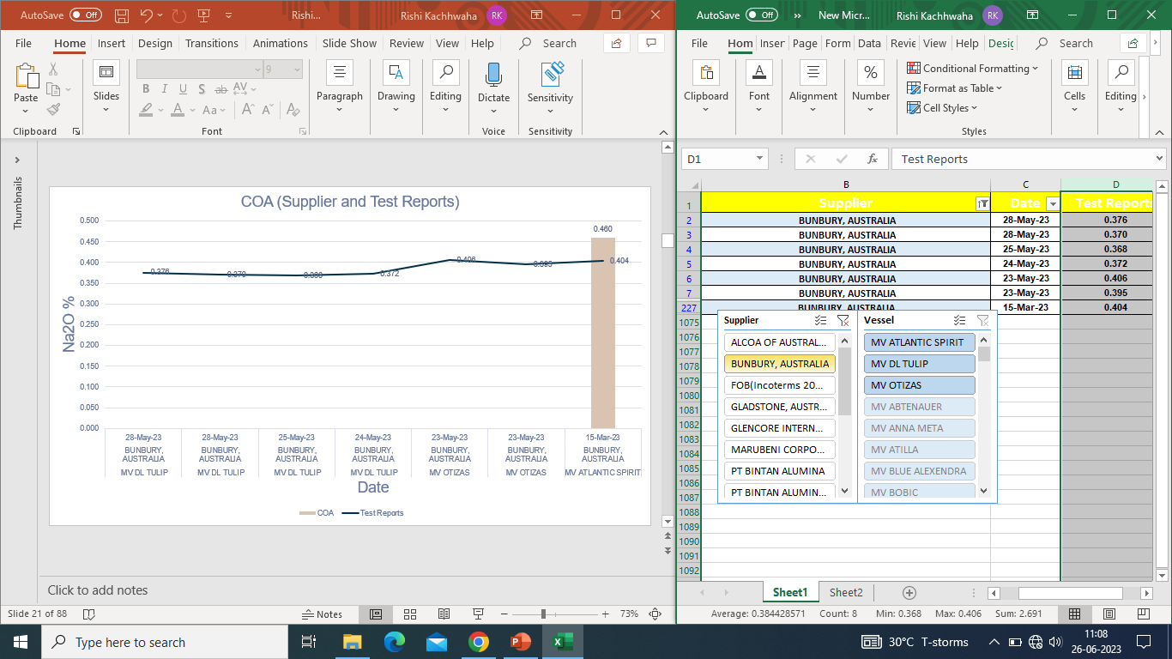

Slide 24
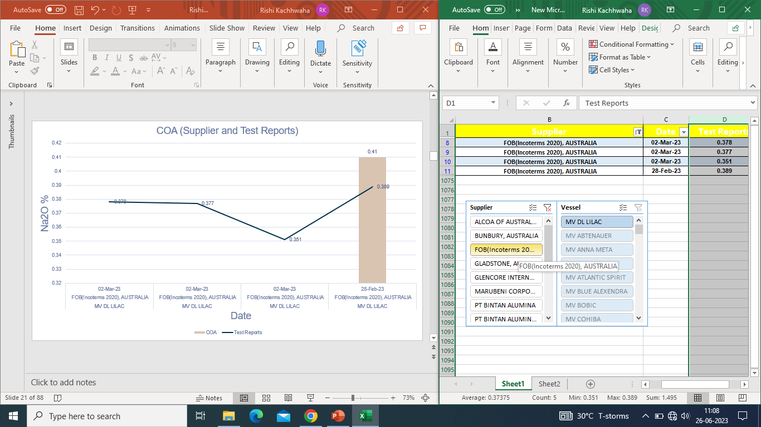

Slide 25
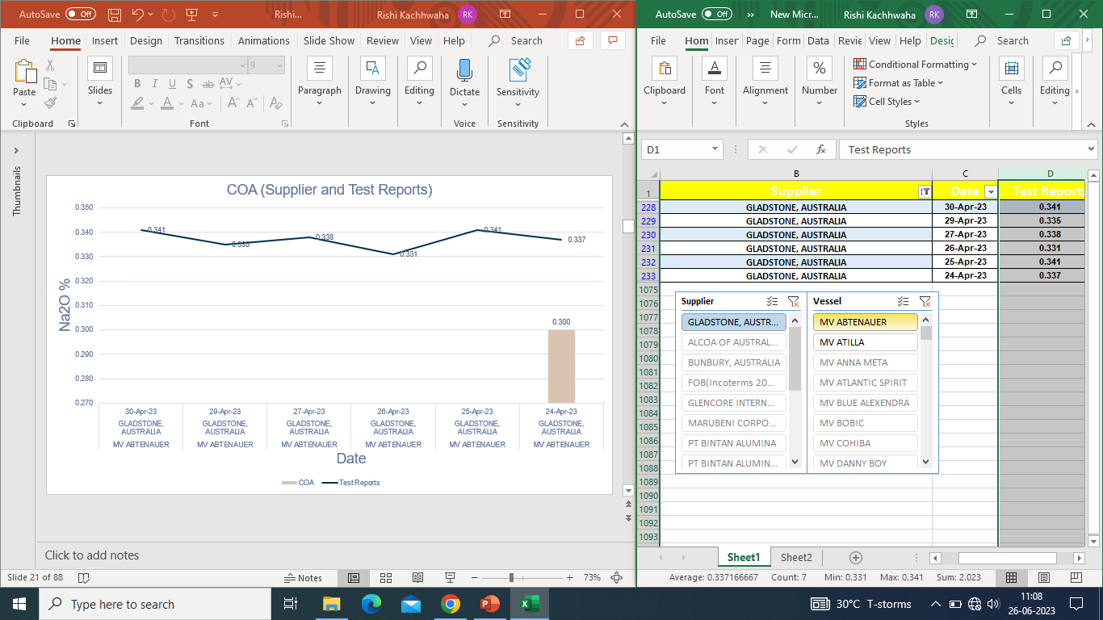

Slide 26
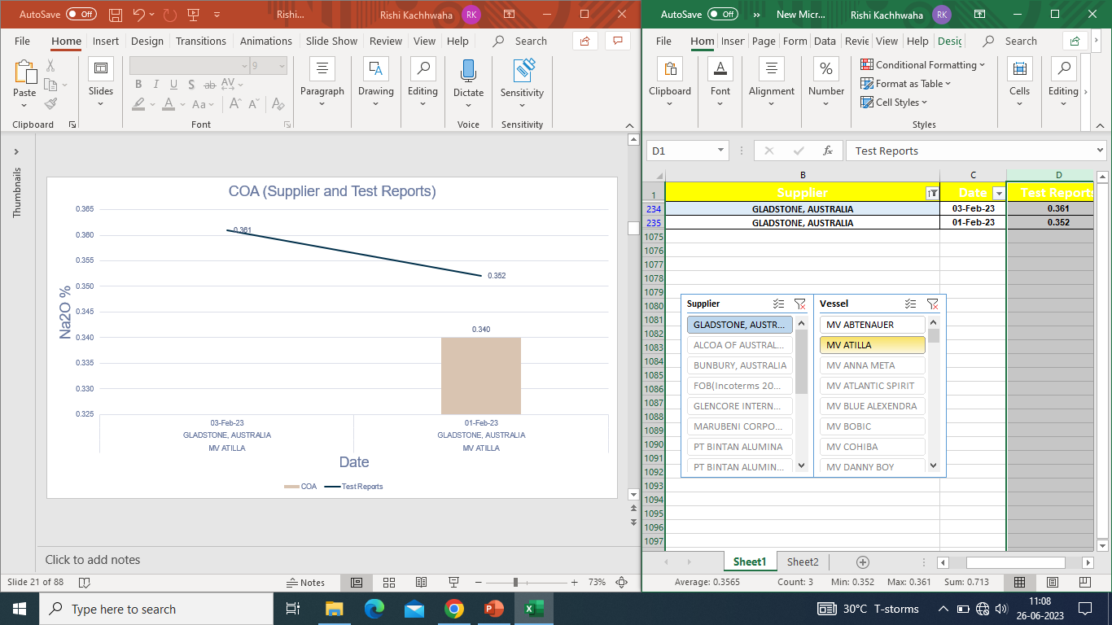

Slide 27
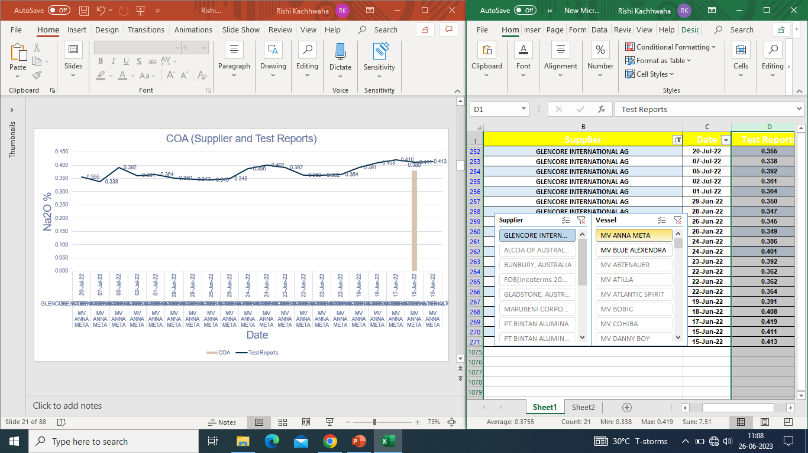

Slide 28
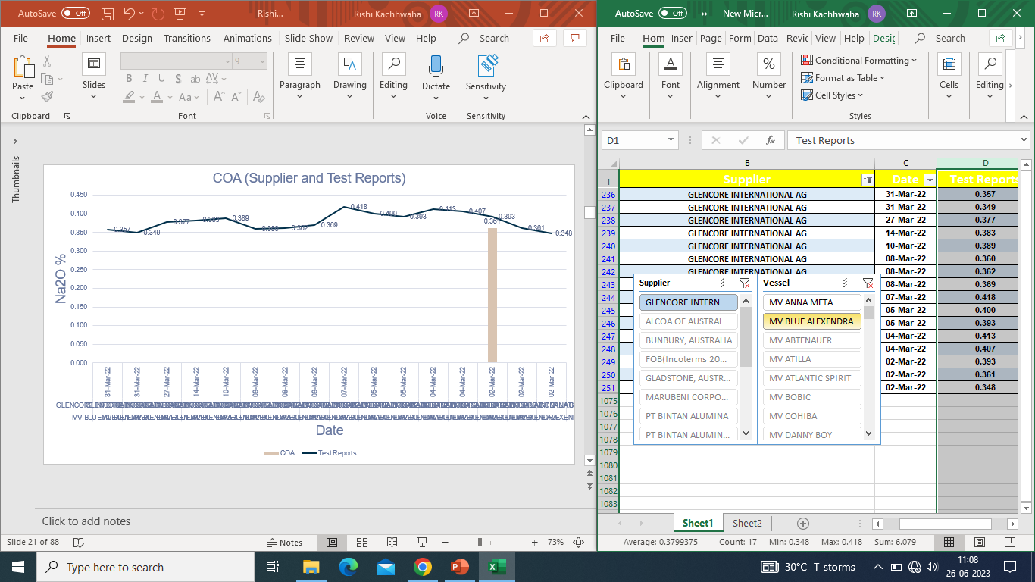

Slide 29
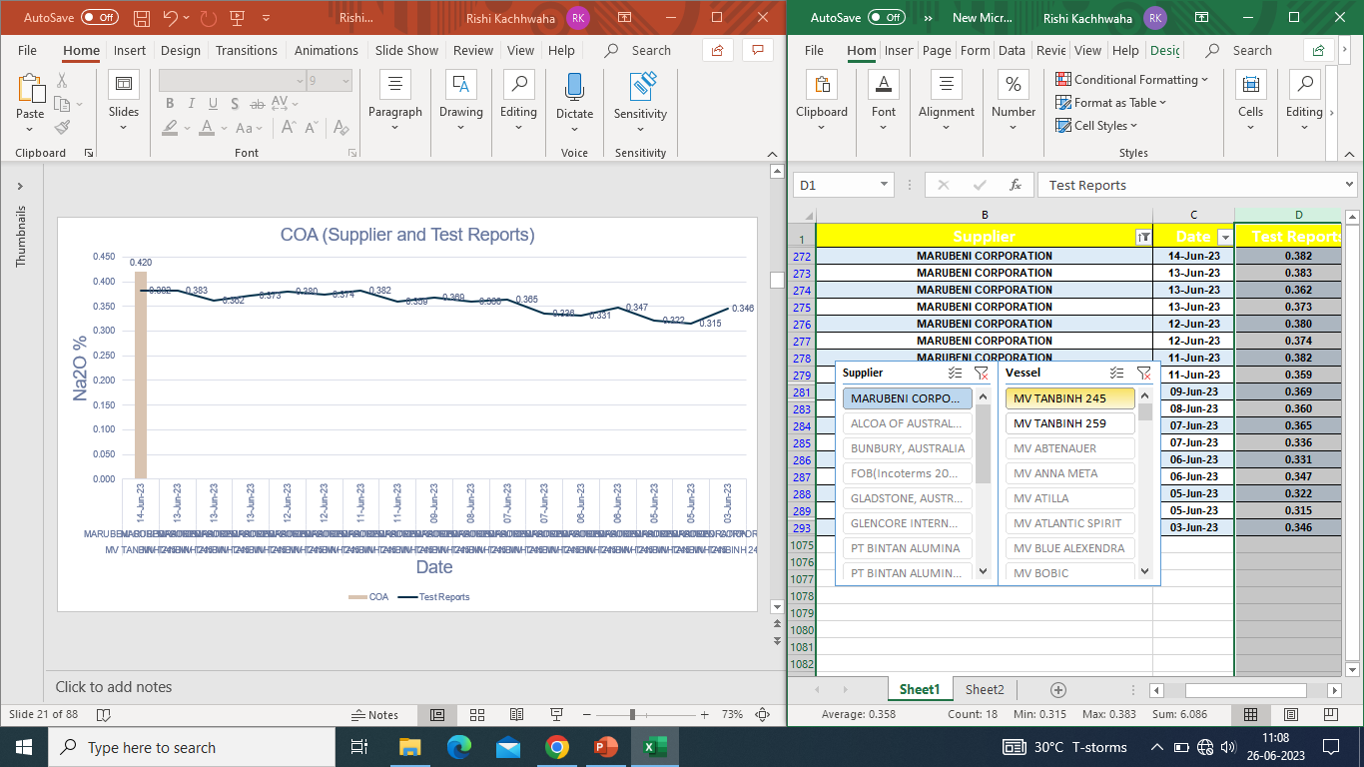

Slide 30
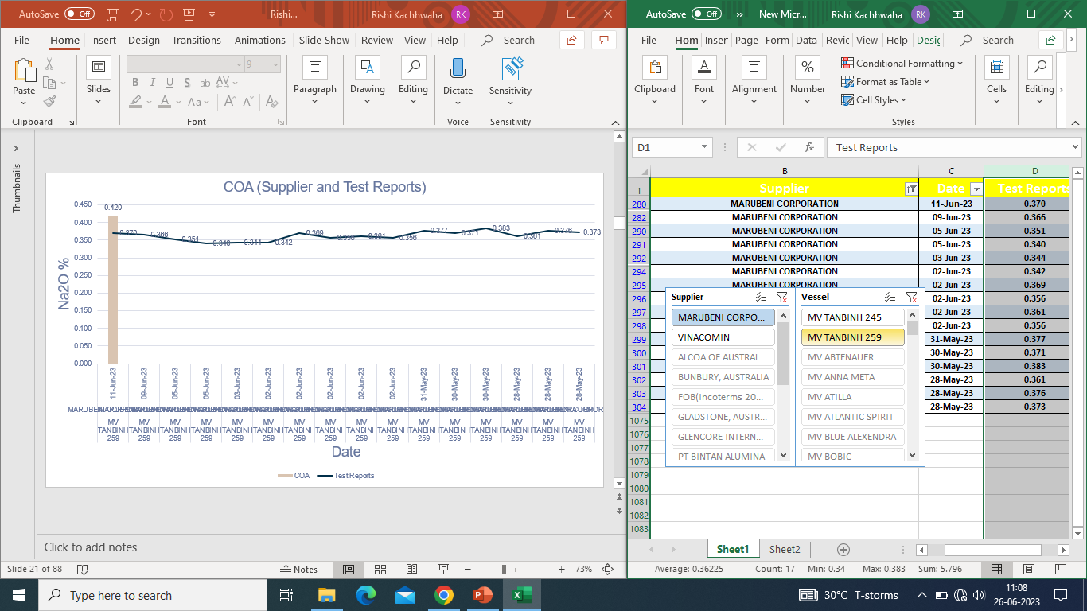

Slide 31
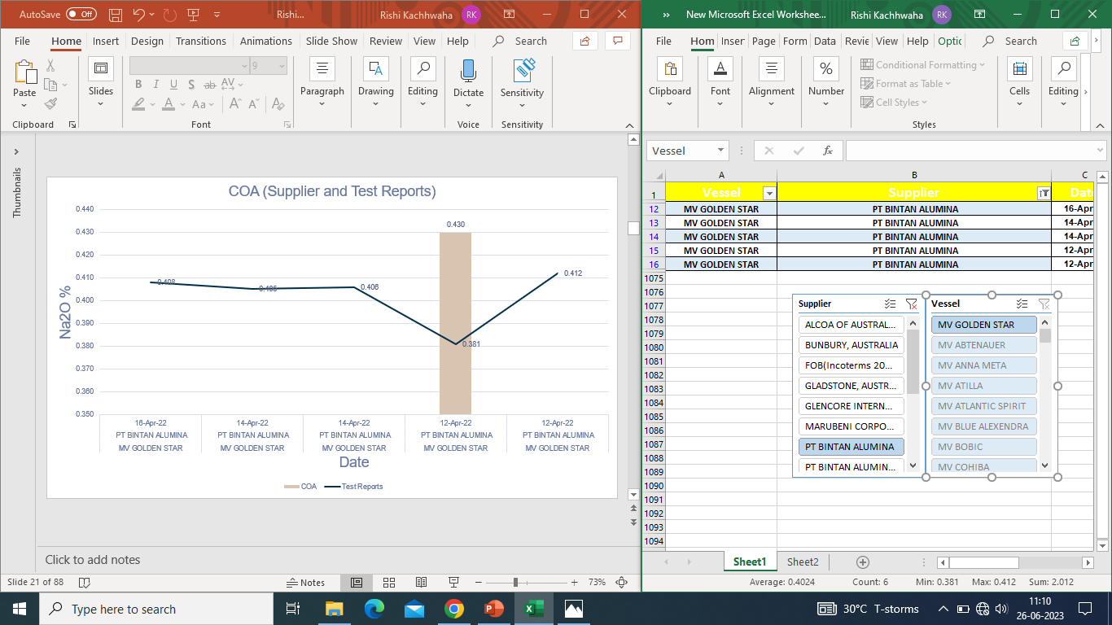

Slide 32
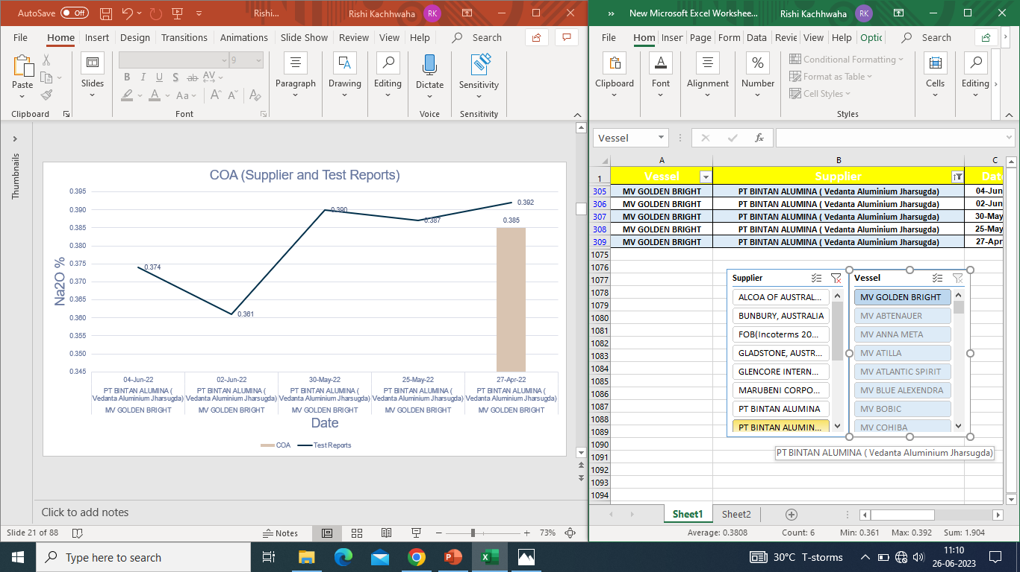

Slide 33
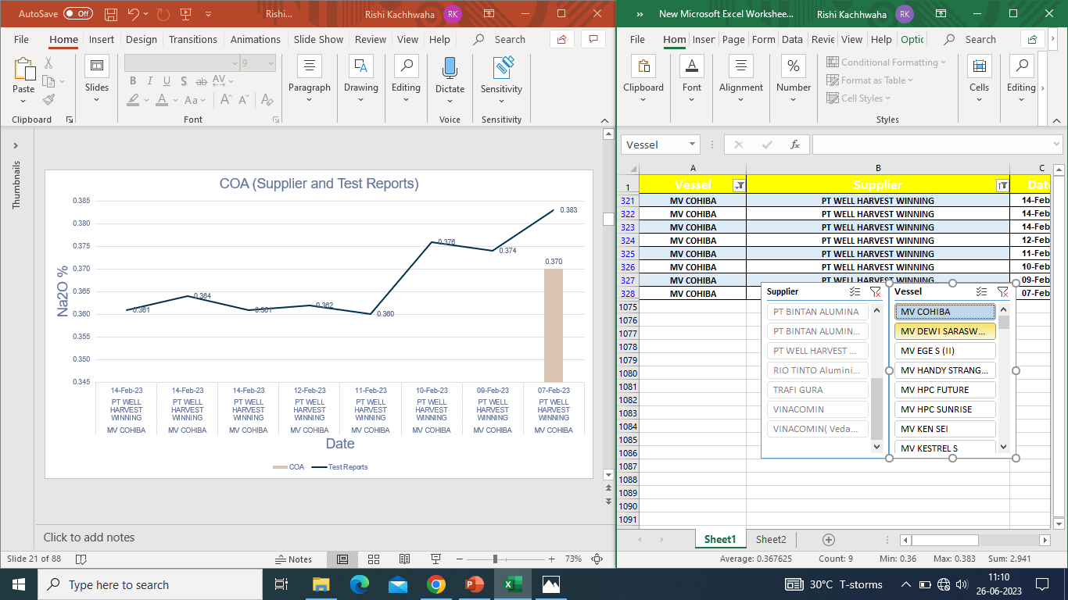

Slide 34
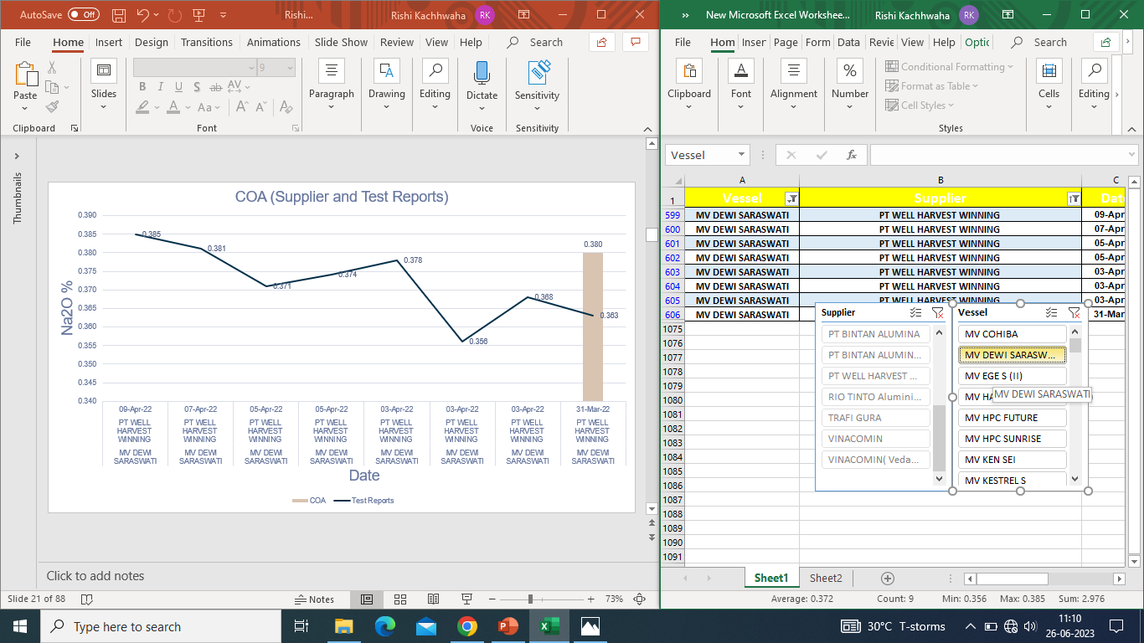

Slide 35
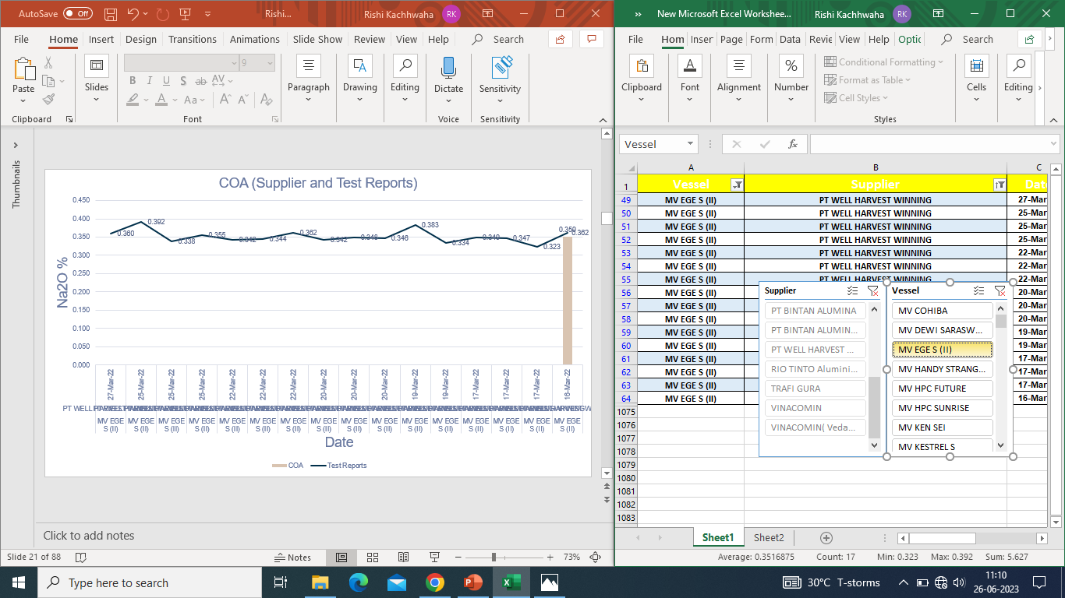

Slide 36
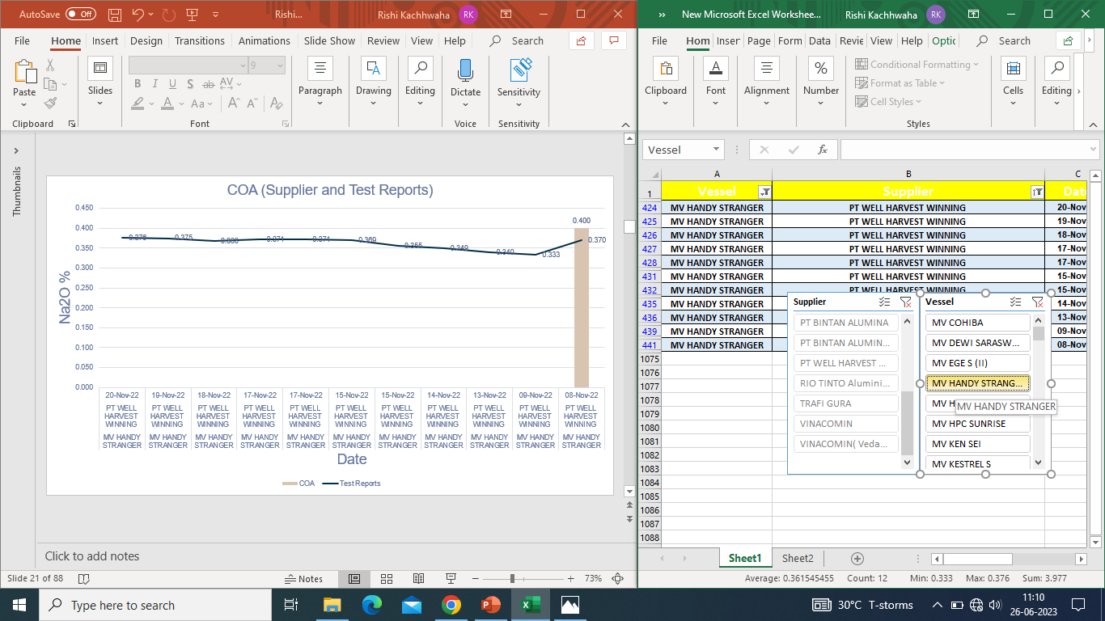

Slide 37


Slide 38
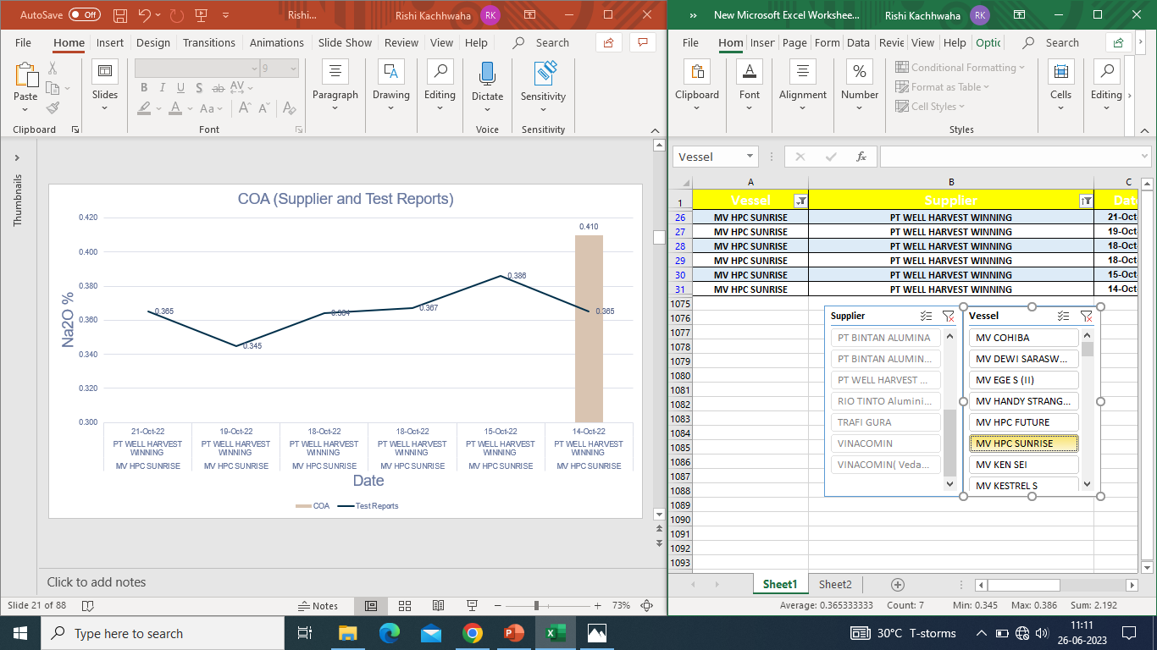

Slide 39
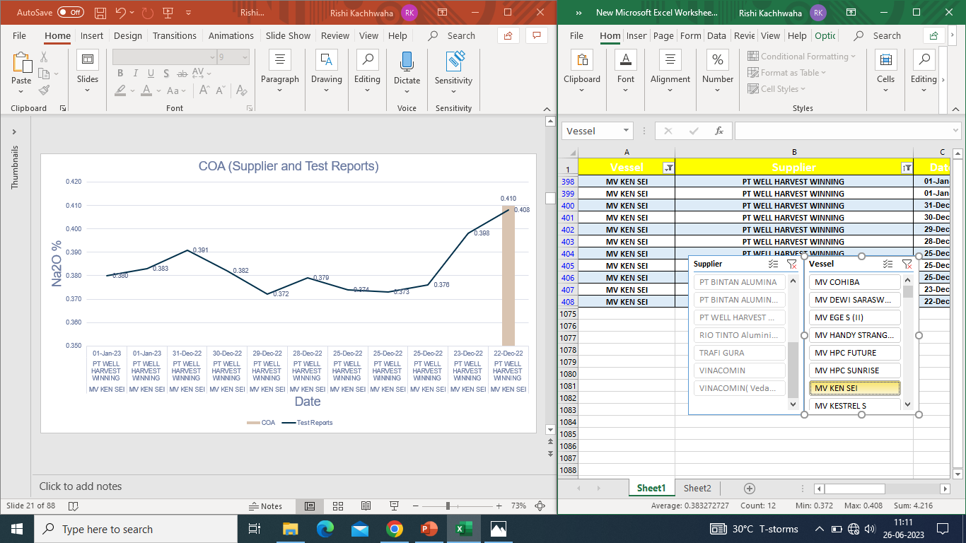

Slide 40
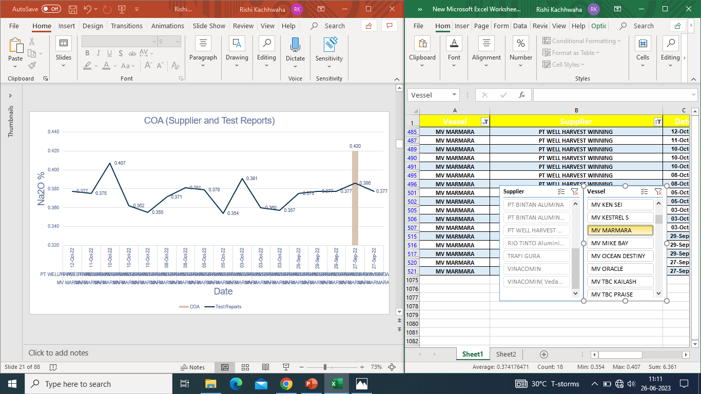

Slide 41
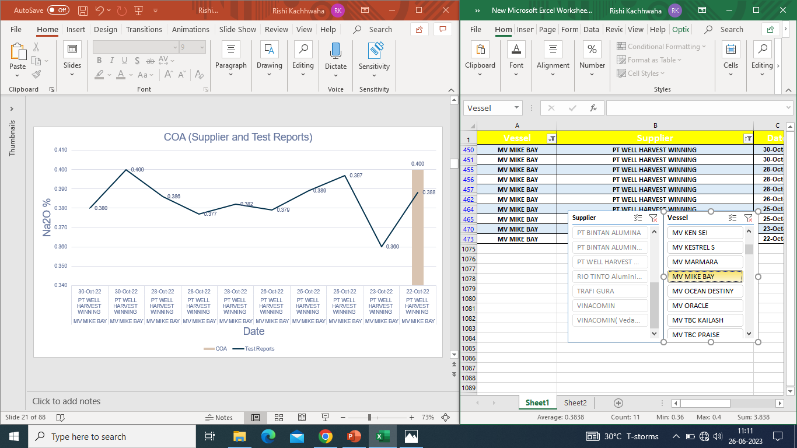

Slide 42
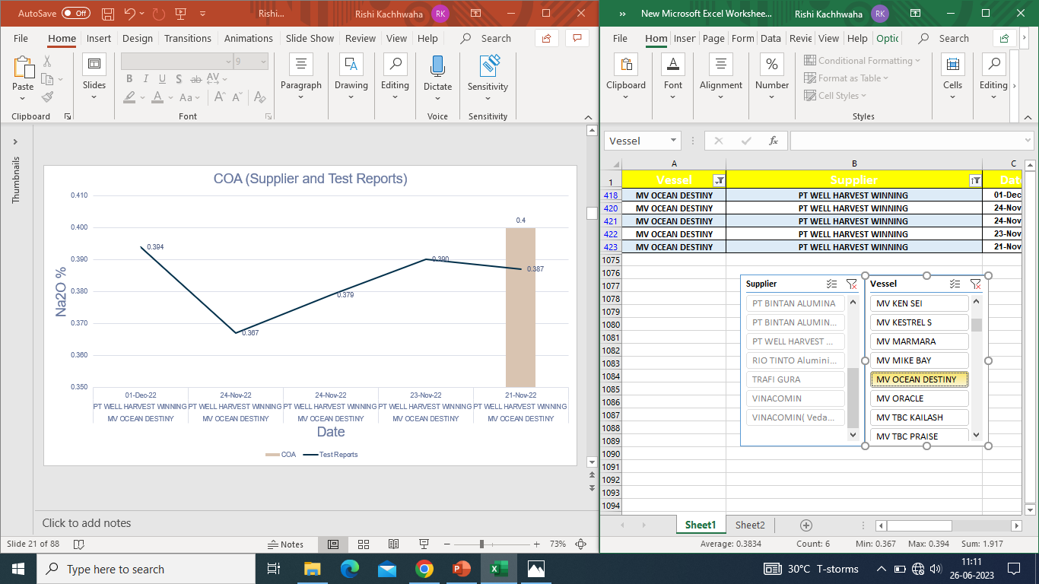

Slide 43


Slide 44


Slide 45


Slide 46
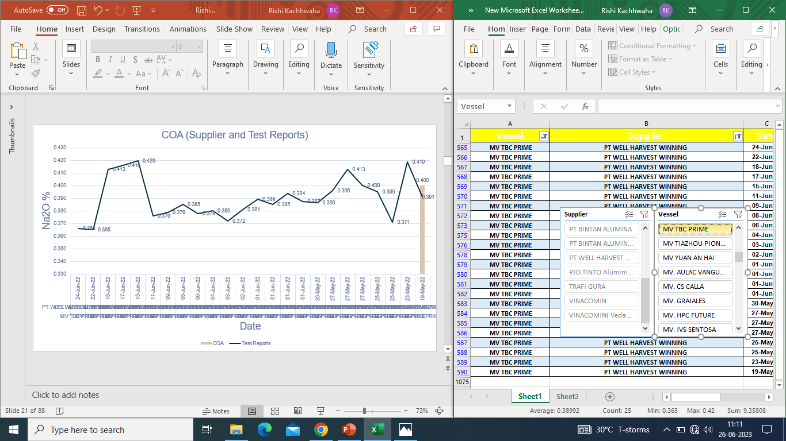

Slide 47


Slide 48
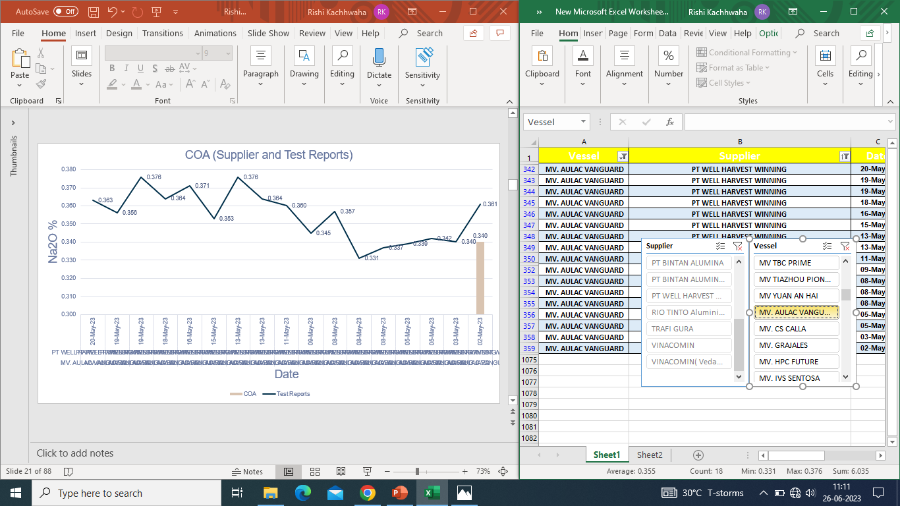

Slide 49


Slide 50
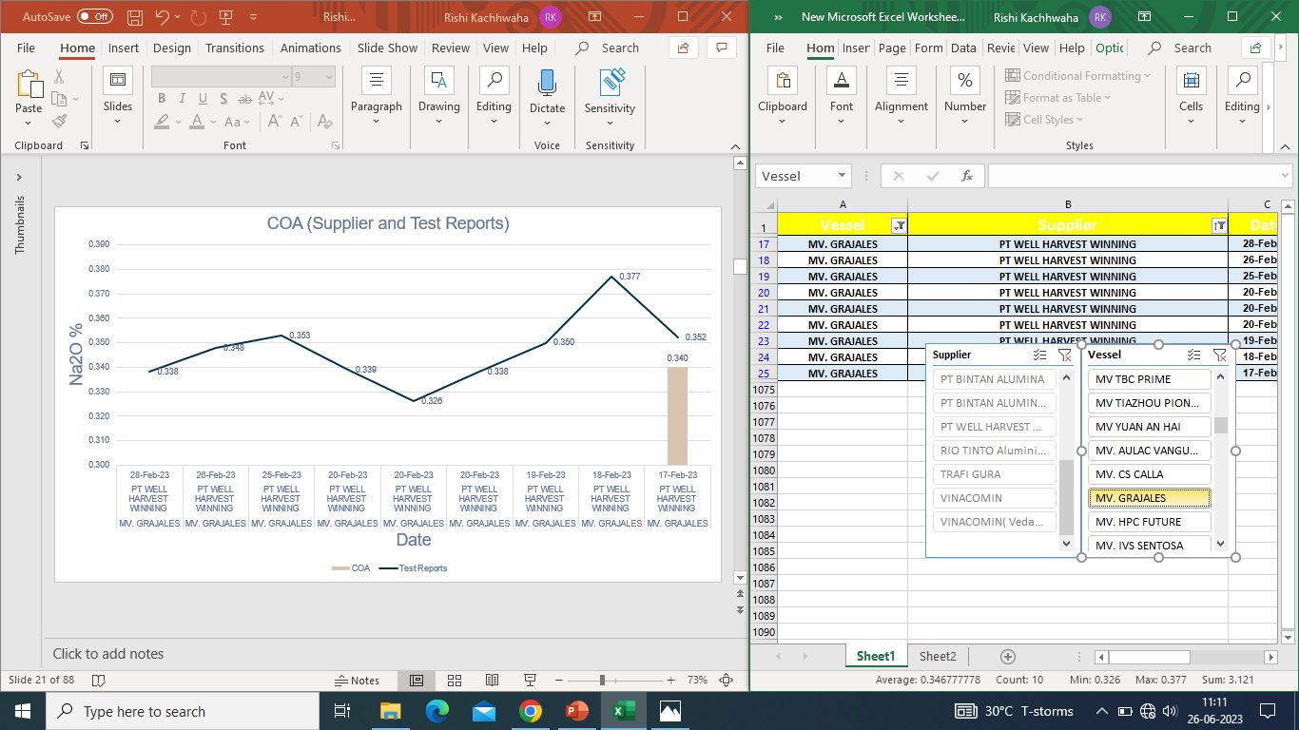

Slide 51


Slide 52


Slide 53
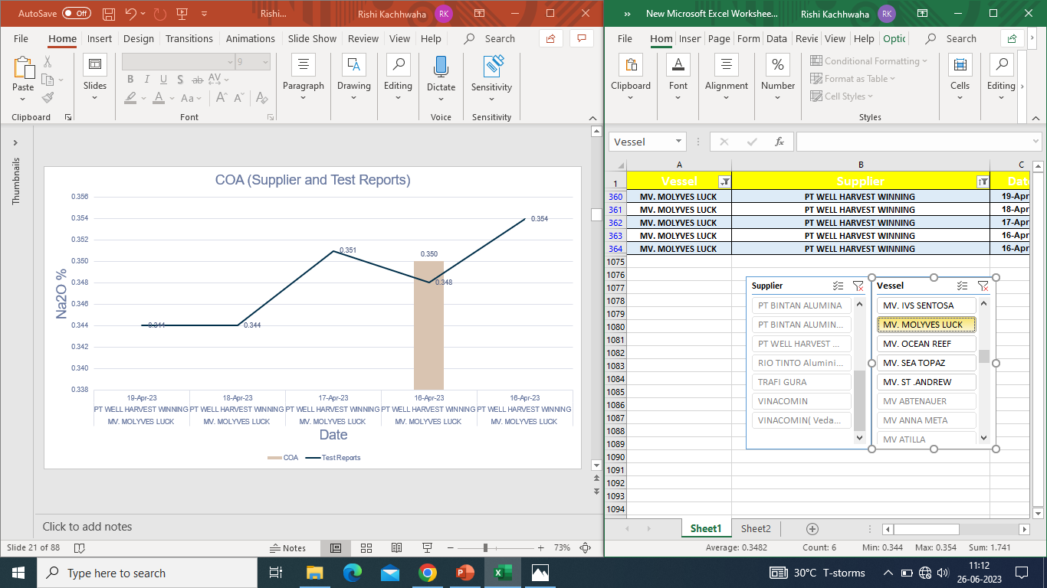

Slide 54
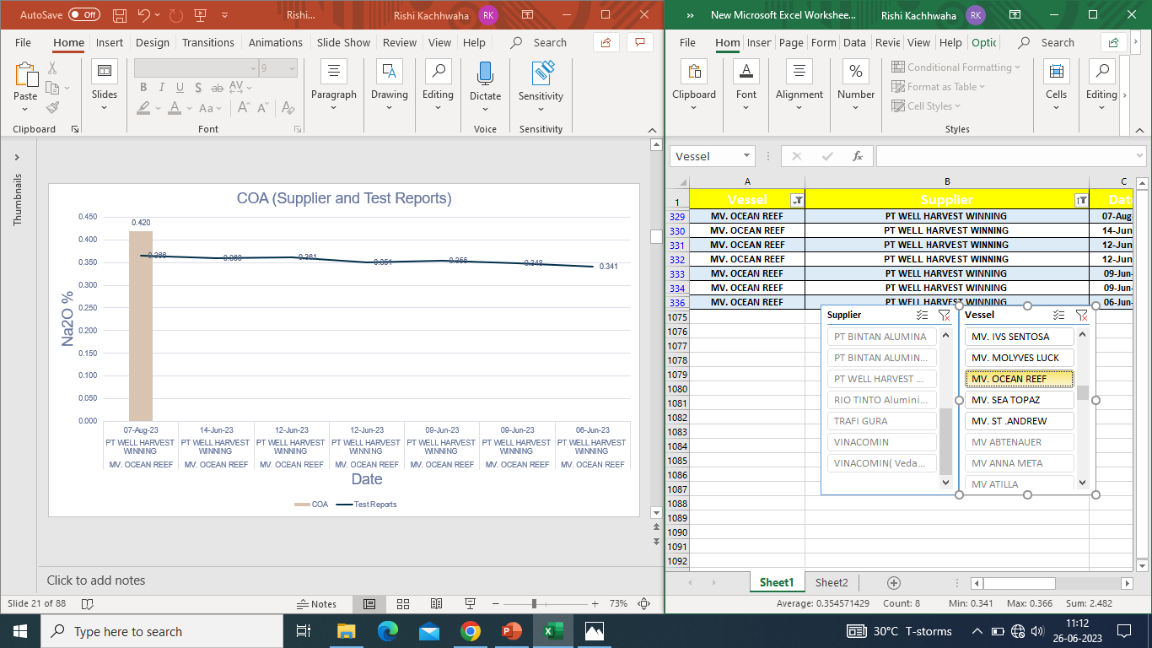

Slide 55


Slide 56
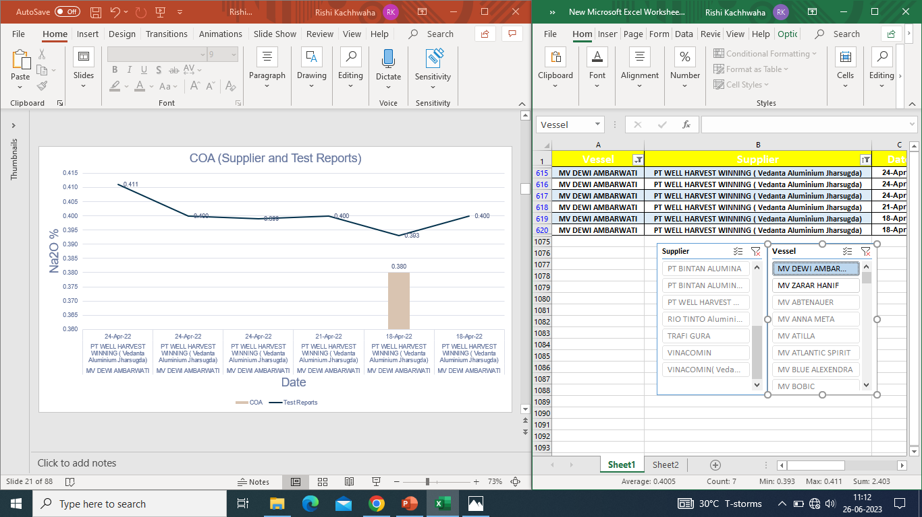

Slide 57
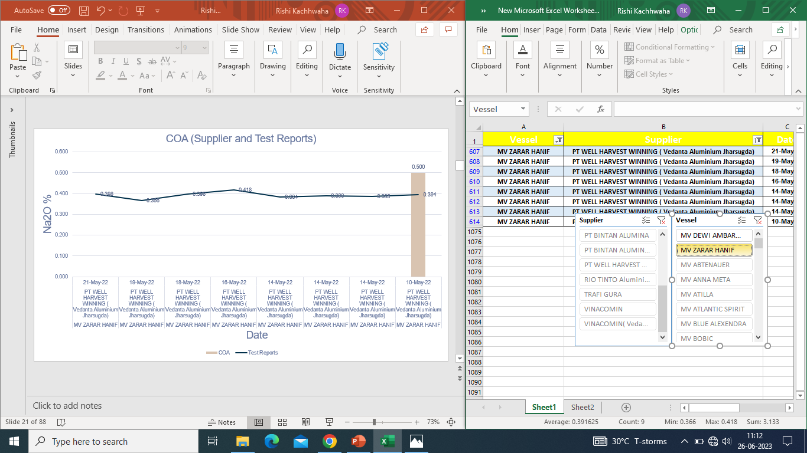

Slide 58
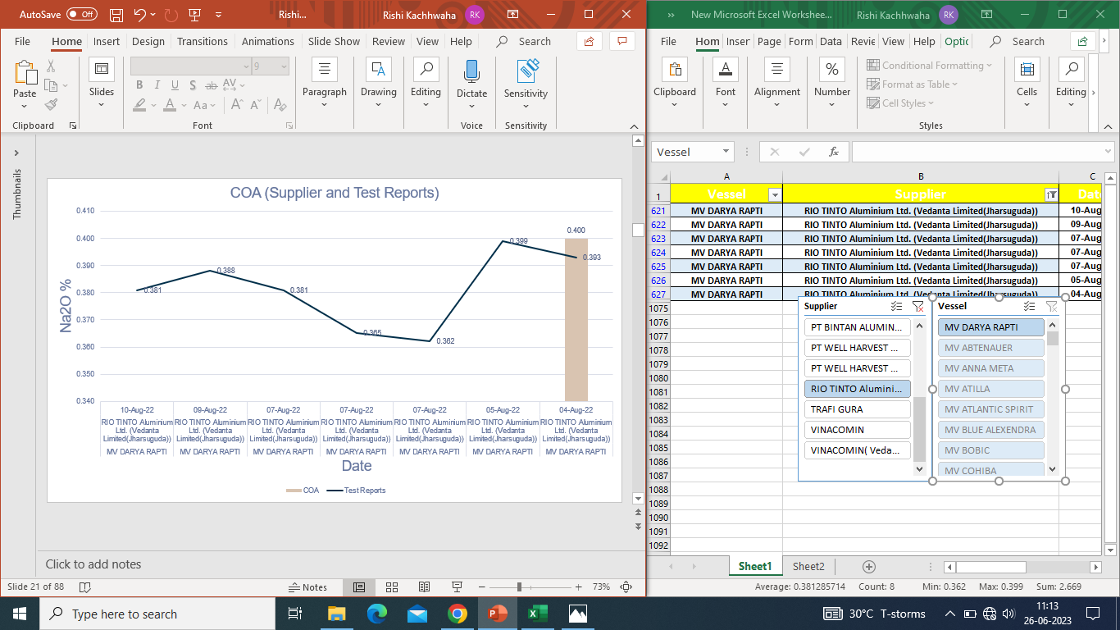

Slide 59
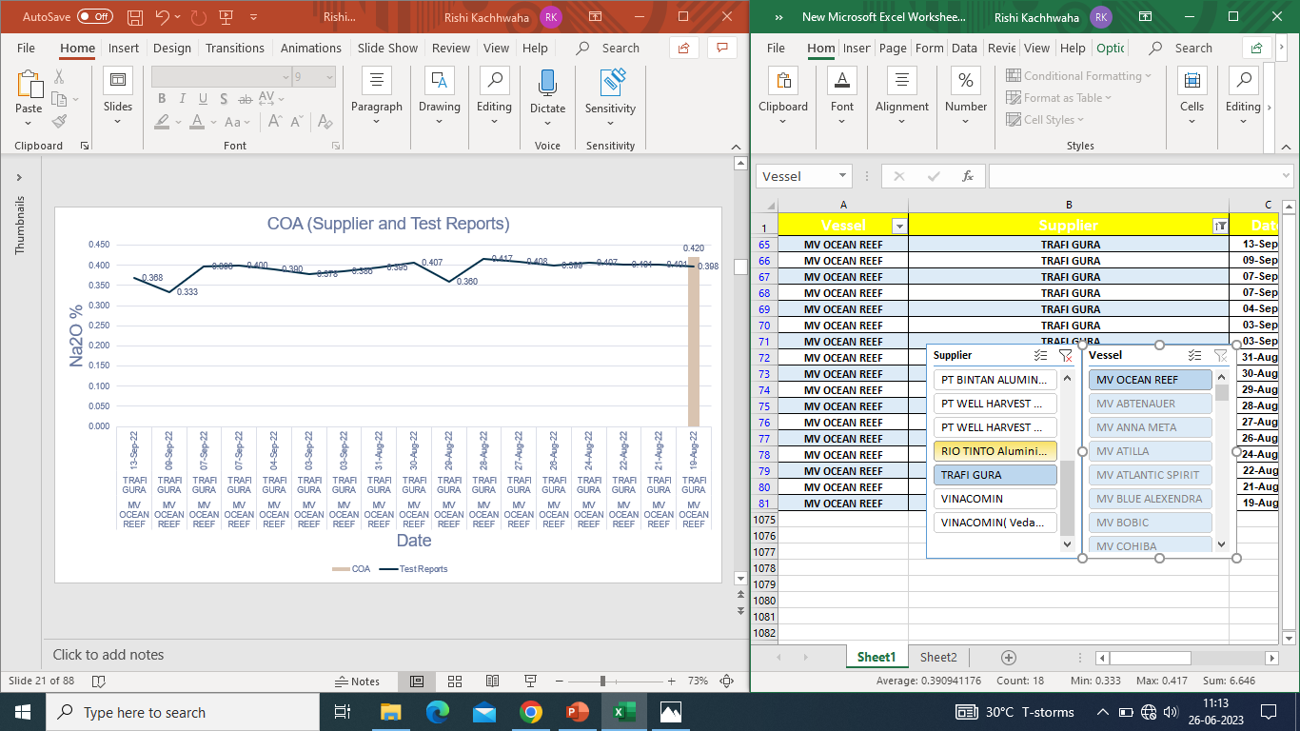

Slide 60
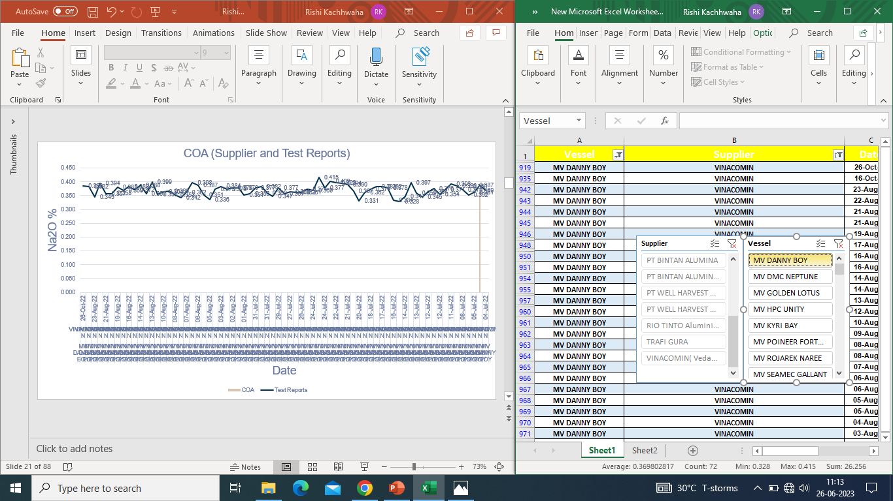

Slide 61
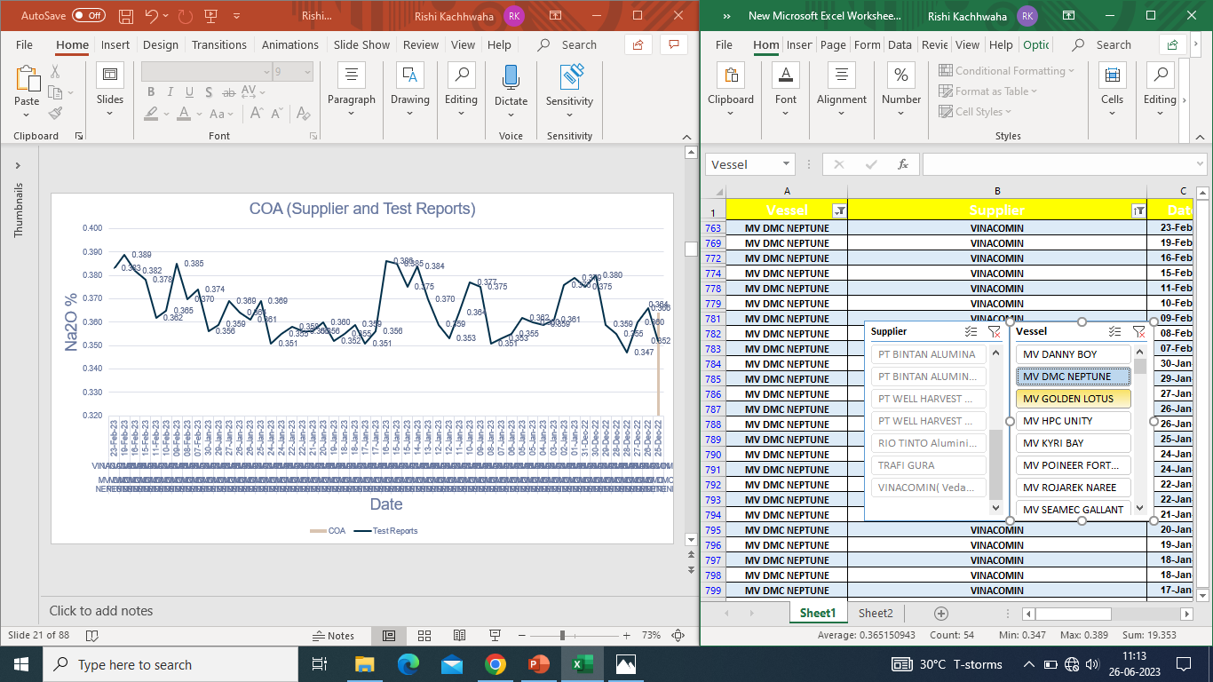

Slide 62
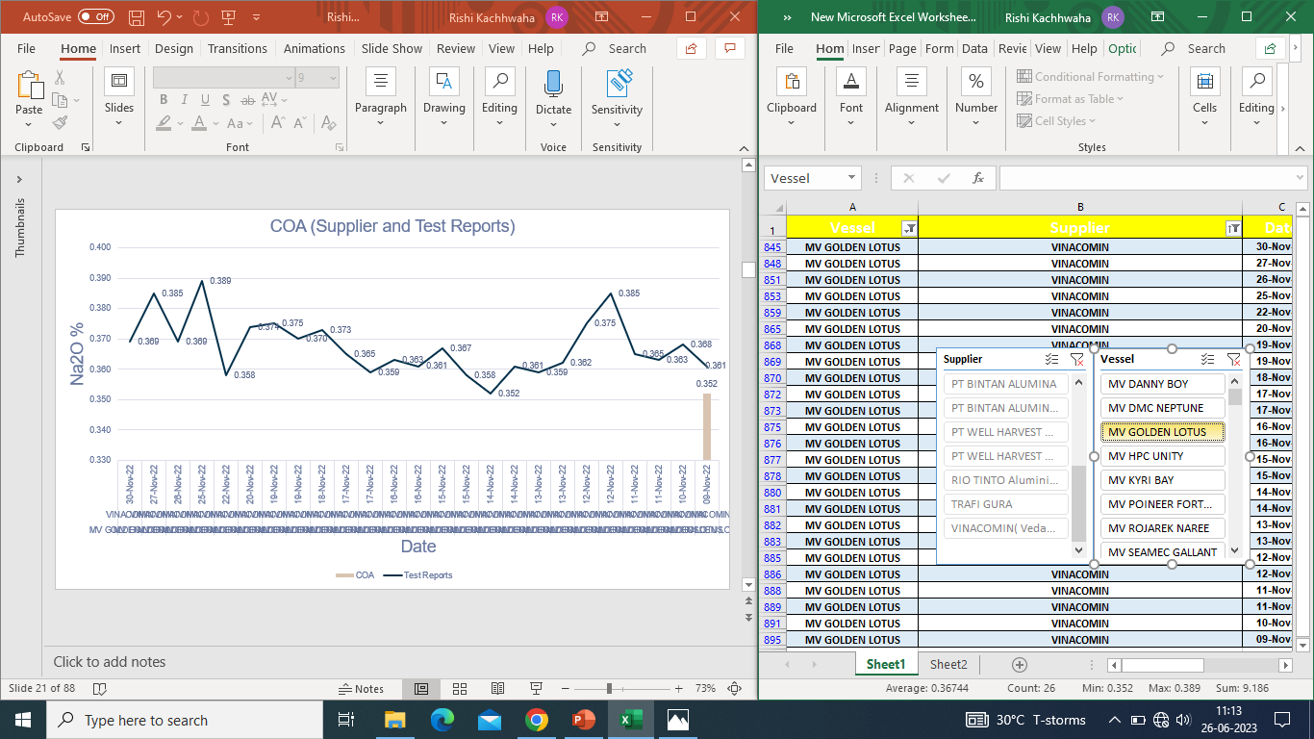

Slide 63


Slide 64
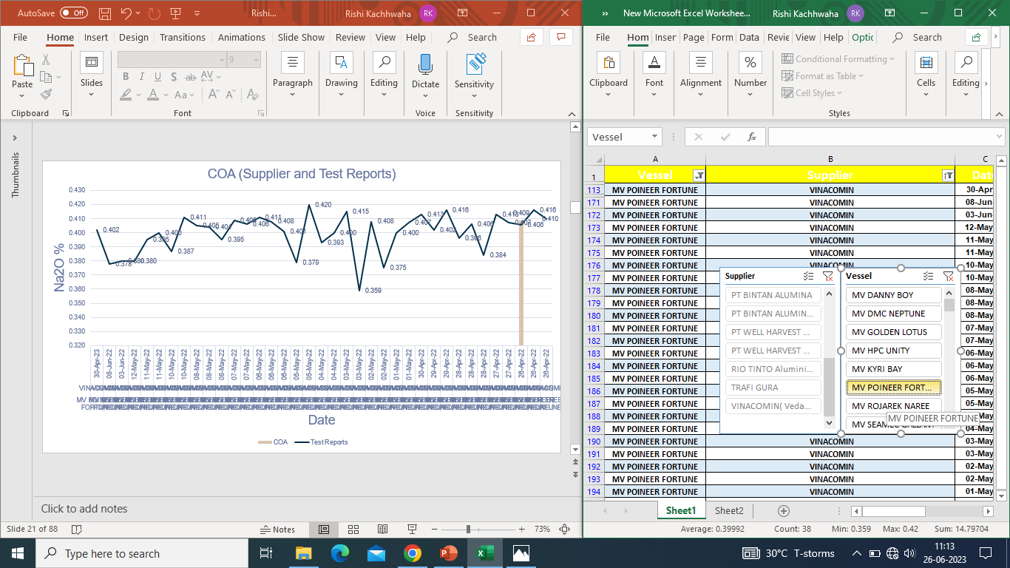

Slide 65


Slide 66
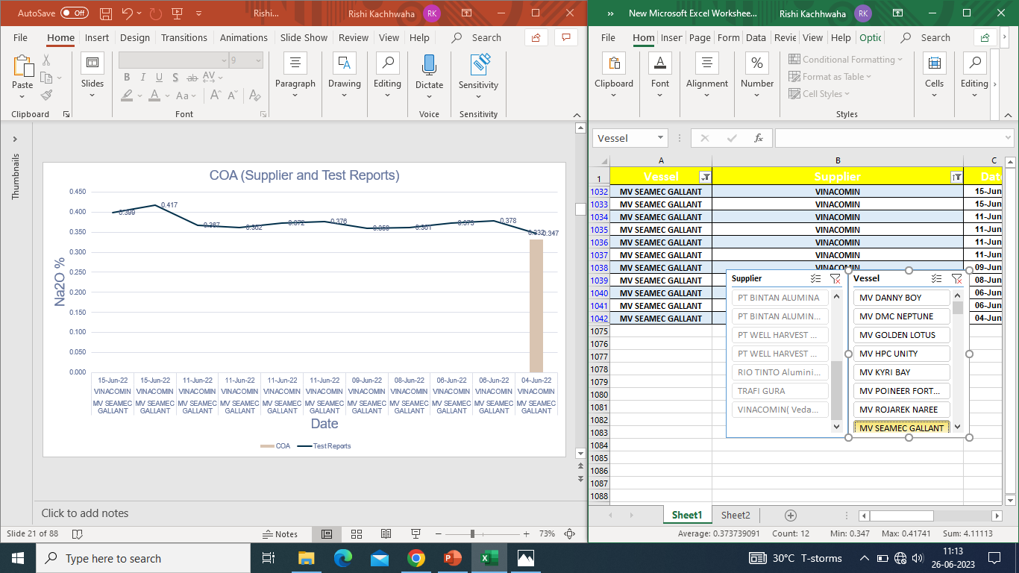

Slide 67
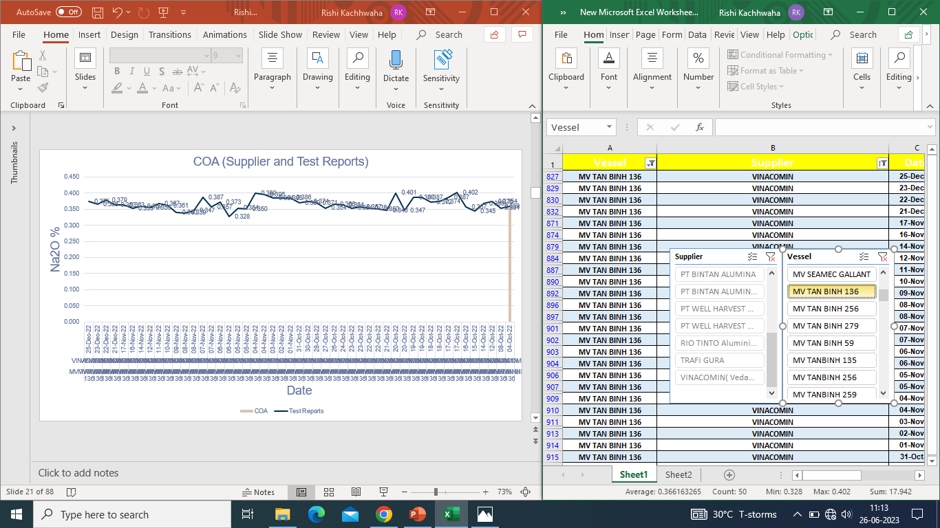

Slide 68
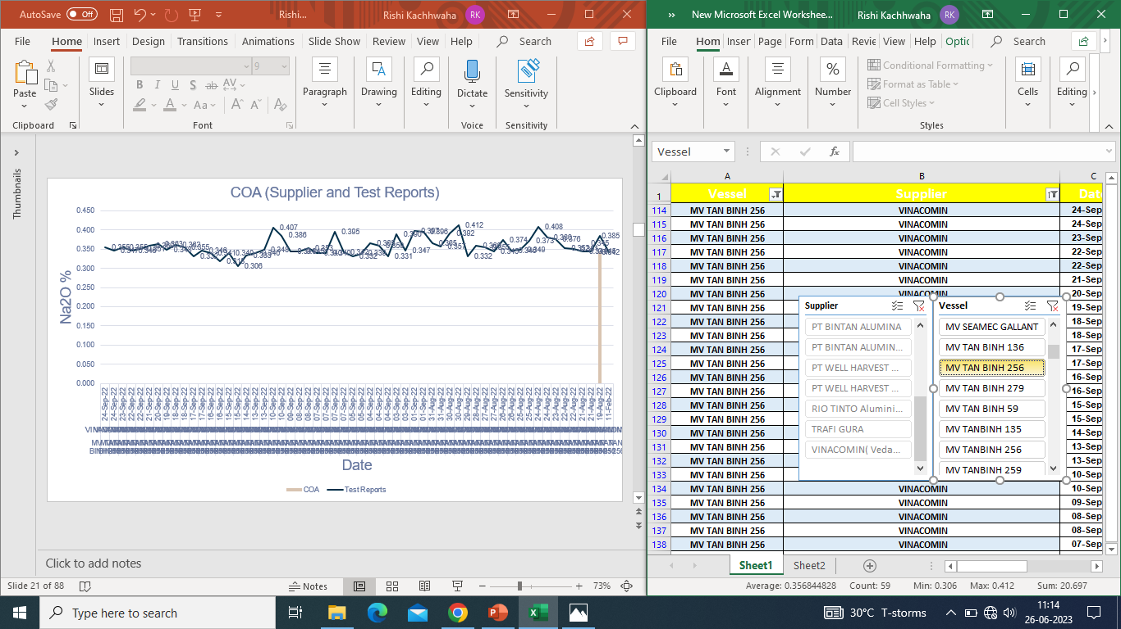

Slide 69


Slide 70


Slide 71


Slide 72


Slide 73


Slide 74


Slide 75


Slide 76


Slide 77


Slide 78
To Summarize…
From analysing the
Steep angle of the silo,
Properties of alumina flowing,
Rotary discharge (single point),
Discharge rate
Data observed
Statement of Port In-Charge,
I conclude that alumina are mixing* and the accusations “COA of both sellers and our tested sample are same” are false, a mixed COA value is being observed both by data and the factors.
*according to my assumption taken earlier

Slide 79
THANK YOU.

